Slide 1
Getting Started with Deep Learning
Seth Juarez
@sethjuarez
Microsoft
aka.ms/myq

Slide 2


Slide 3


Slide 4
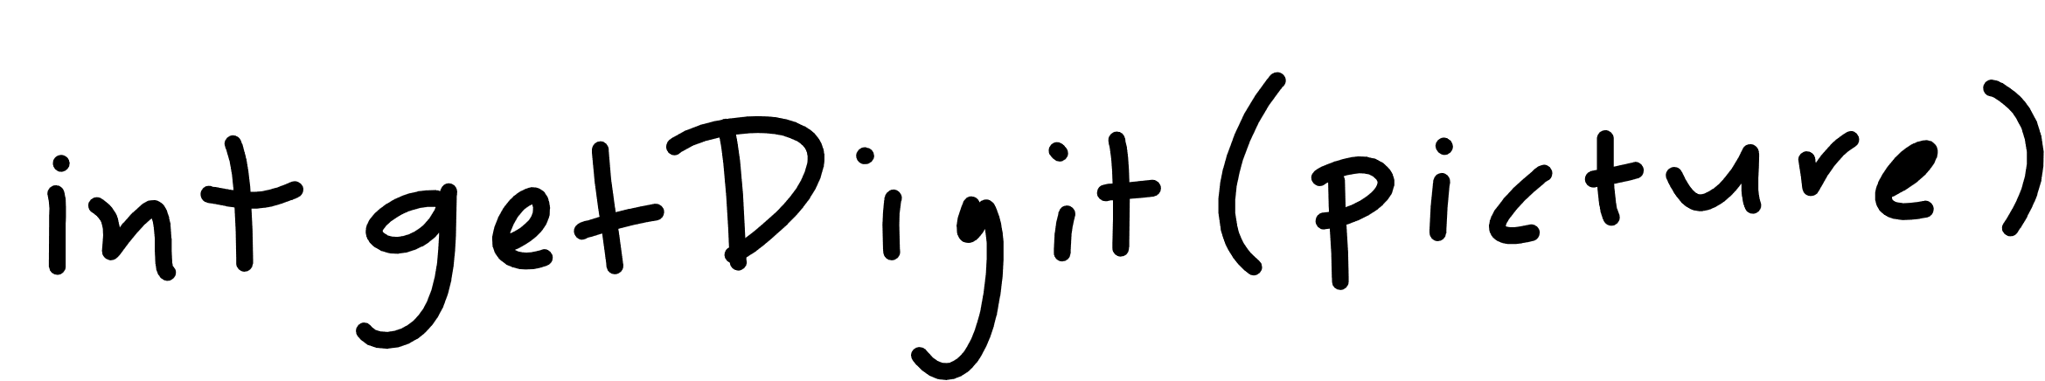

Slide 5

Notes:
Cover the fact that ML uses data to make its own functions

Slide 6
machine learning
how much / how many
which class does this belong to?
are there different groups? which does it belong to?
is this weird?
which option should I choose?

Slide 7
machine learning
(regression) how much / how many
(classification) which class does this belong to?
(clustering) are there different groups? which does it belong to?
(anomaly detection) is this weird?
(recommendation) which option should I choose?
supervised
learning
unsupervised
learning

Slide 8
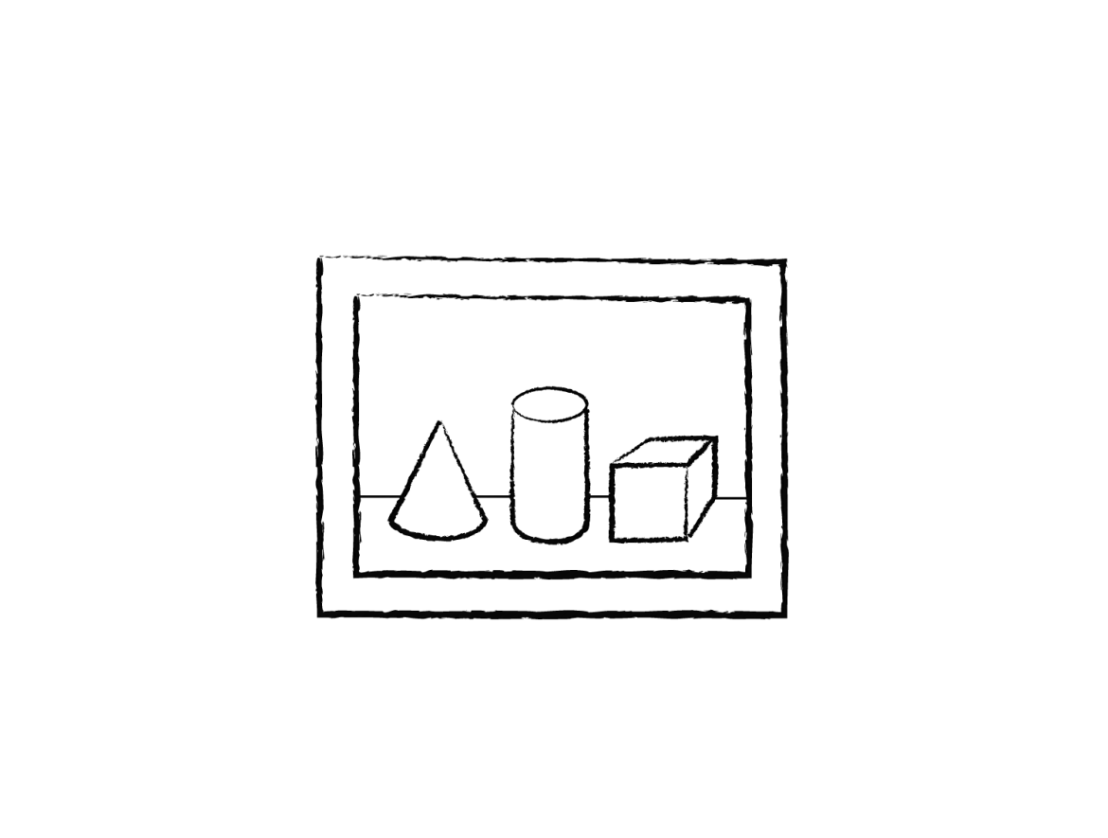

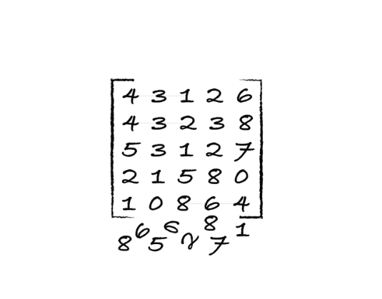
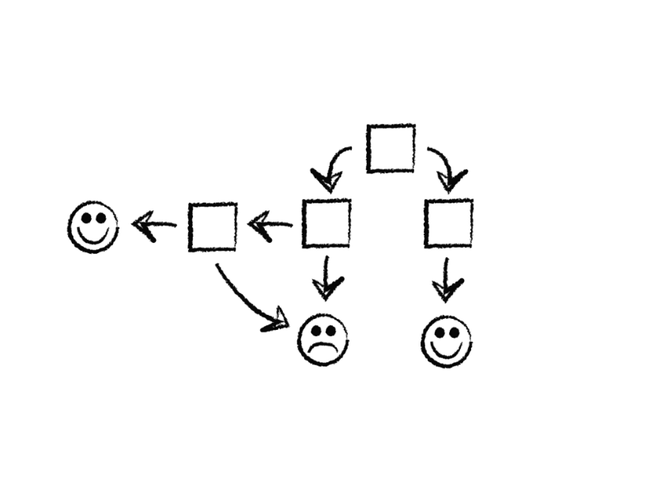
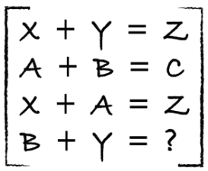
process
identify
predict
1
4
explore
analyze
encode
model
2
3

Slide 9
how well is it doing?
Train
Test
Use ~80%
Use ~20%

Slide 10
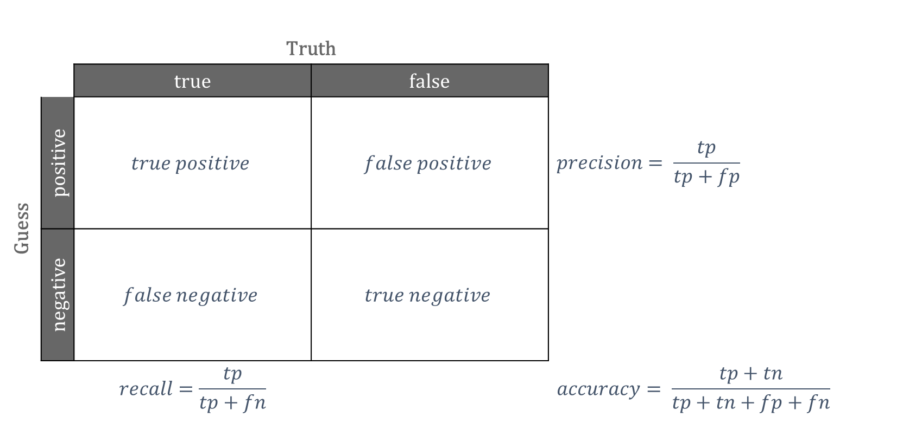
confusion matrix
 |  | Truth
 |  | true | false
Guess | positive | $$true positive$$ | $$false positive$$ | $$precision= \frac{tp}{tp+fp}$$
 | negative | $$false negative$$ | $$true negative$$
 |  | $$recall=\frac{tp}{tp+fn}$$ |  | $$accuracy= \frac{tp+tn}{tp+tn+fp+fn}$$

Slide 11
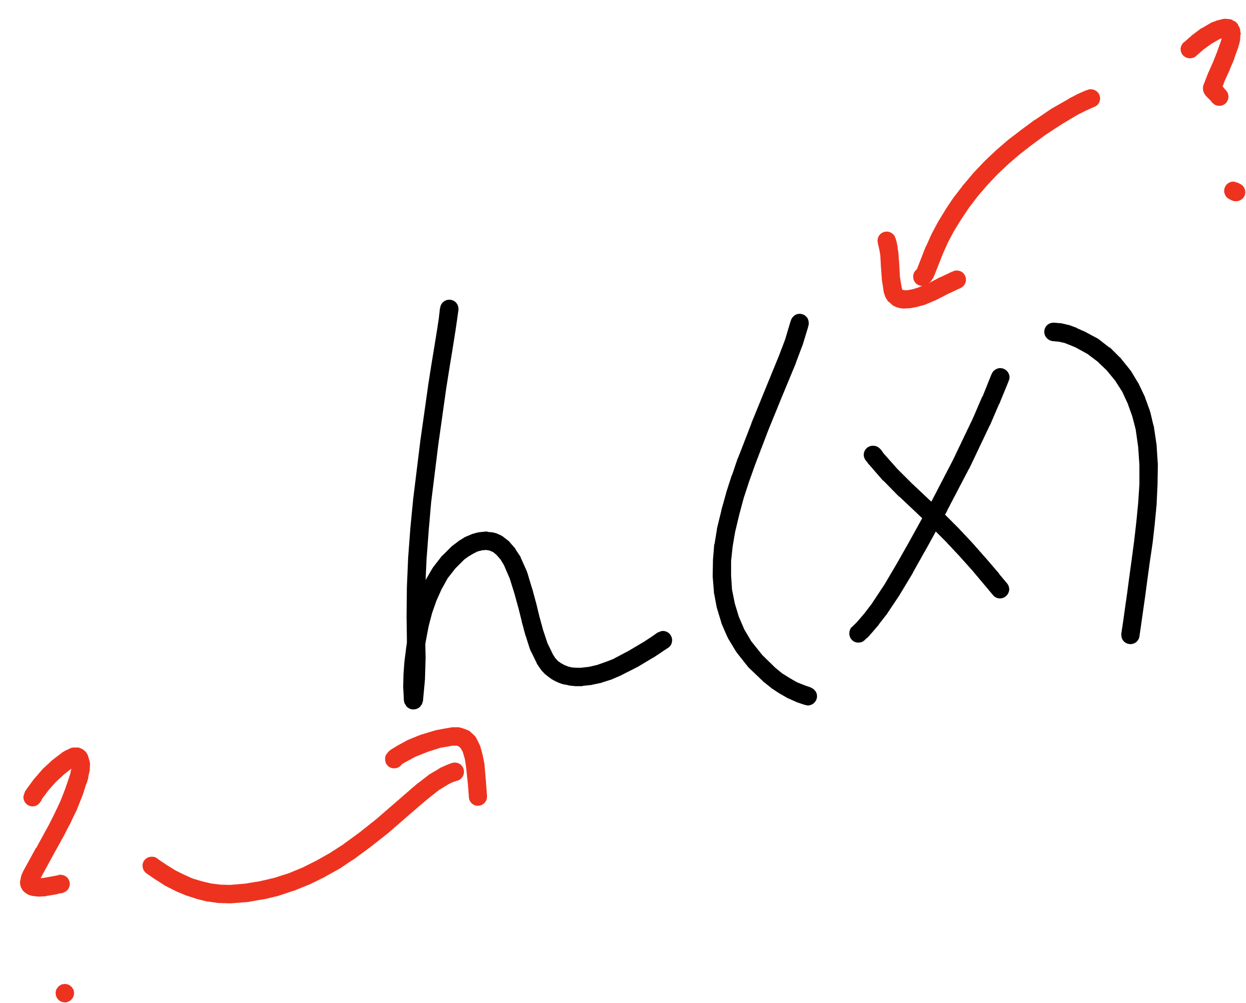
Notes:
Open mnist data representation

Slide 12
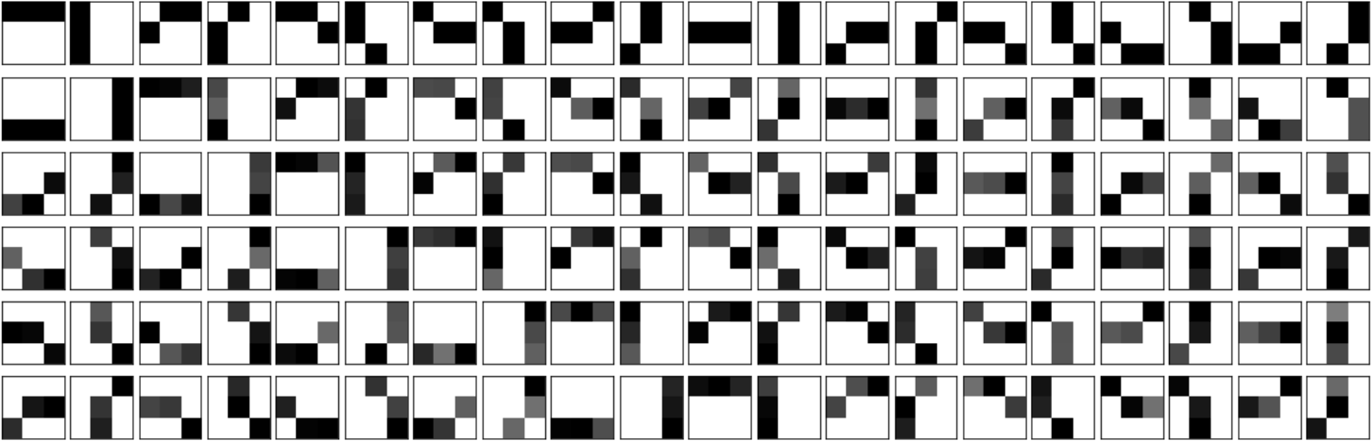

Slide 13
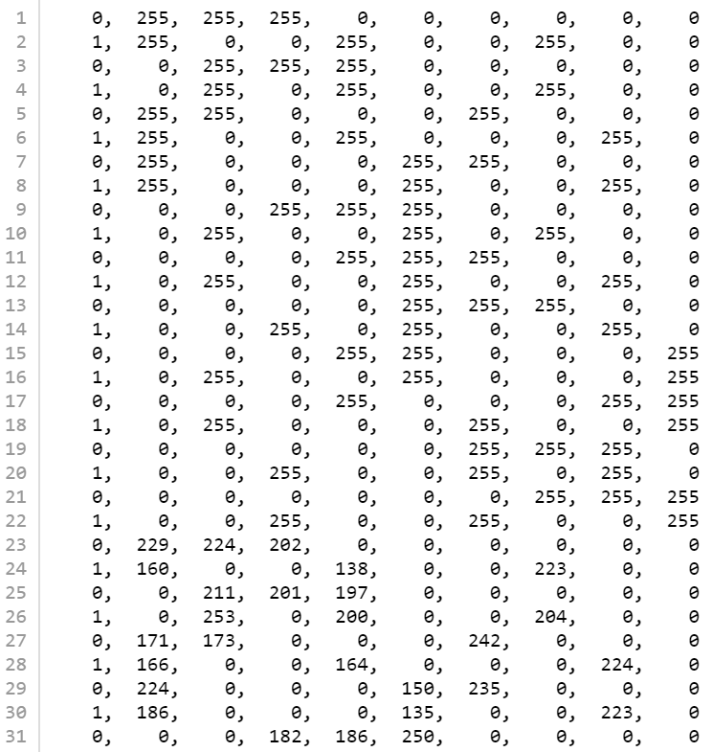


Slide 14
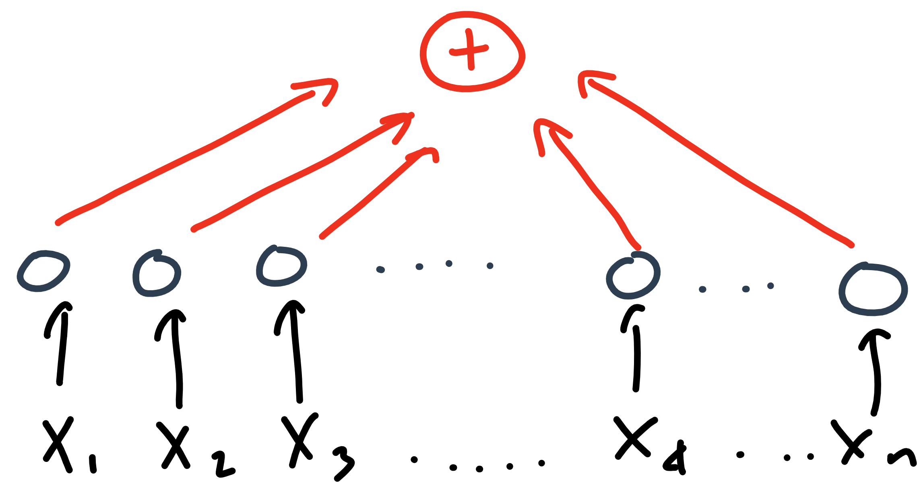

Slide 15
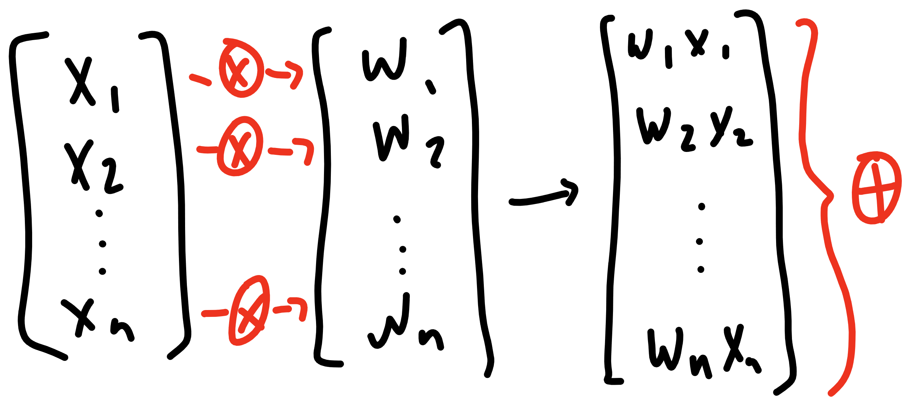

Slide 16
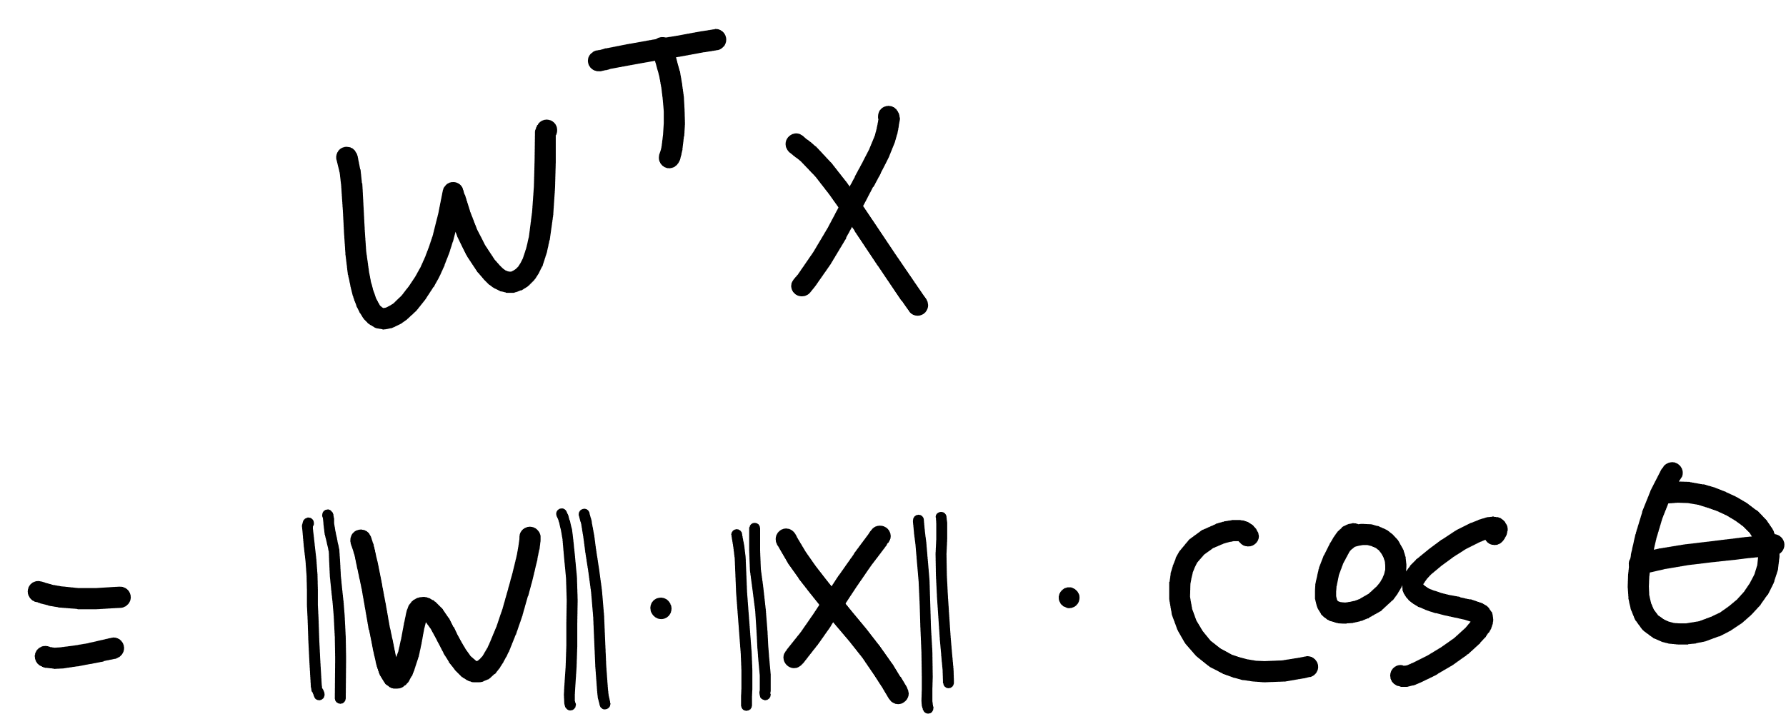

Slide 17
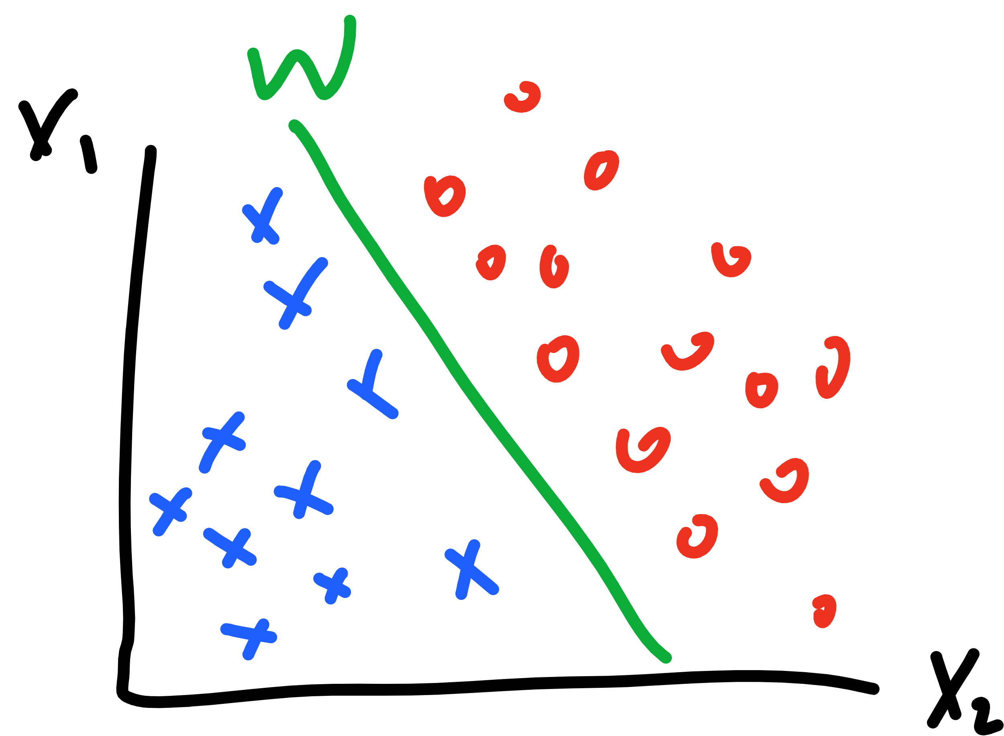

Slide 18
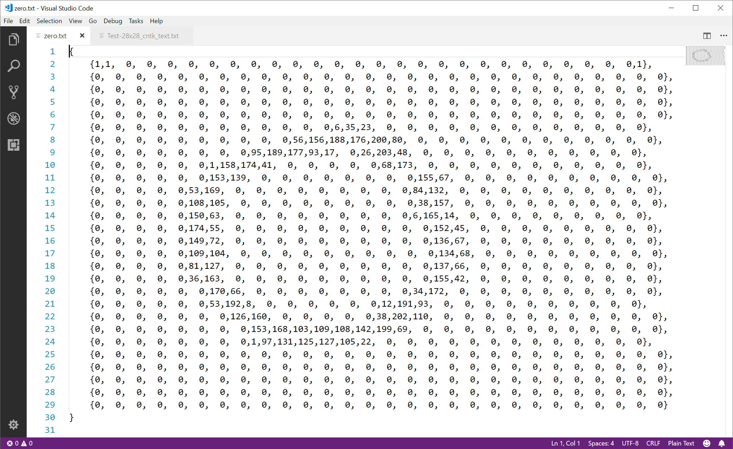

Slide 19
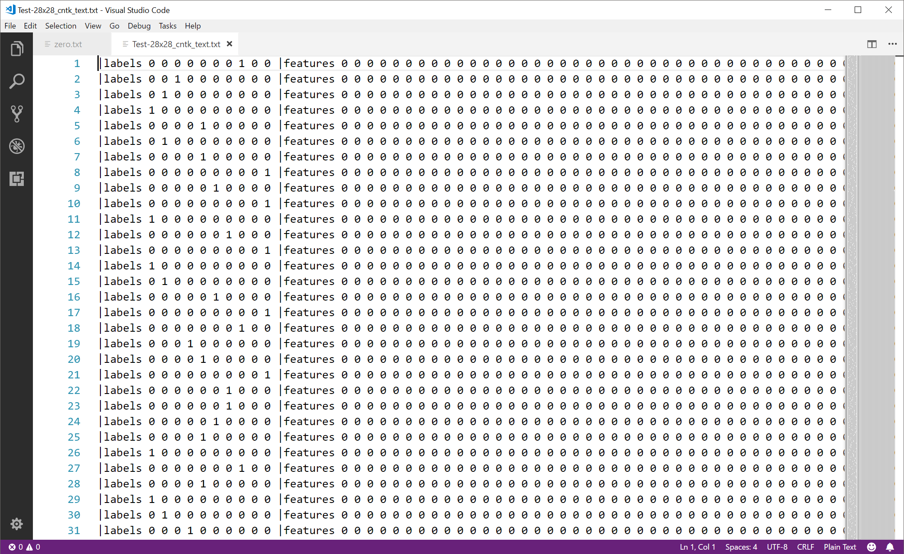

Slide 20
Notes:
Single output
What about one-hot encoded?

Slide 21
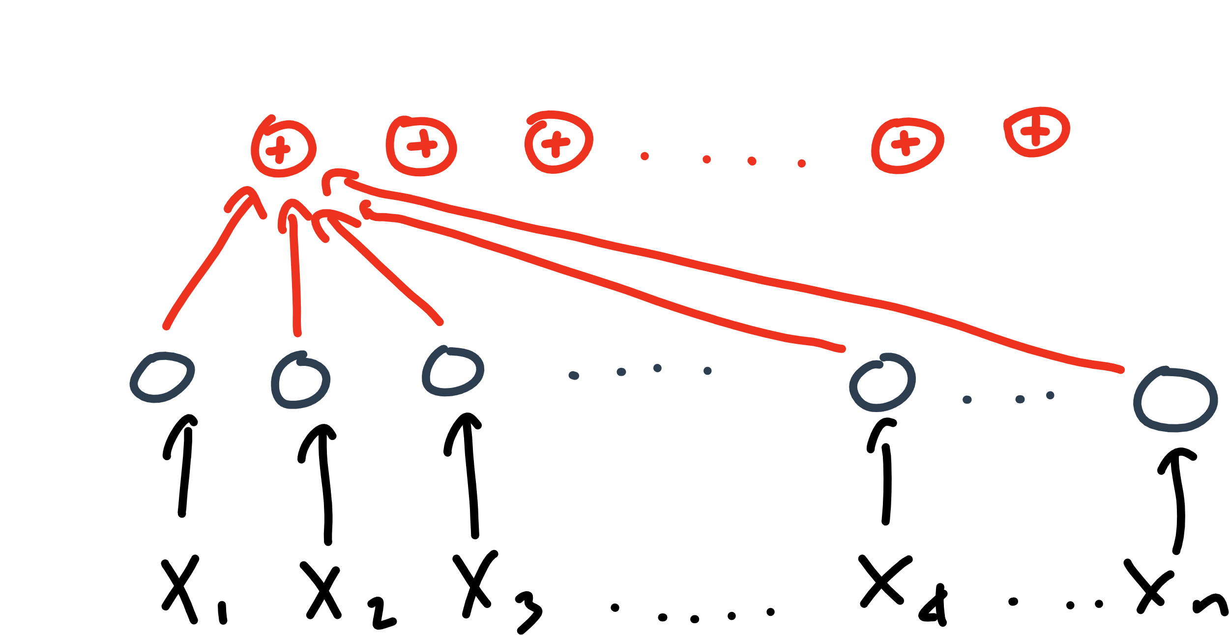

Slide 22
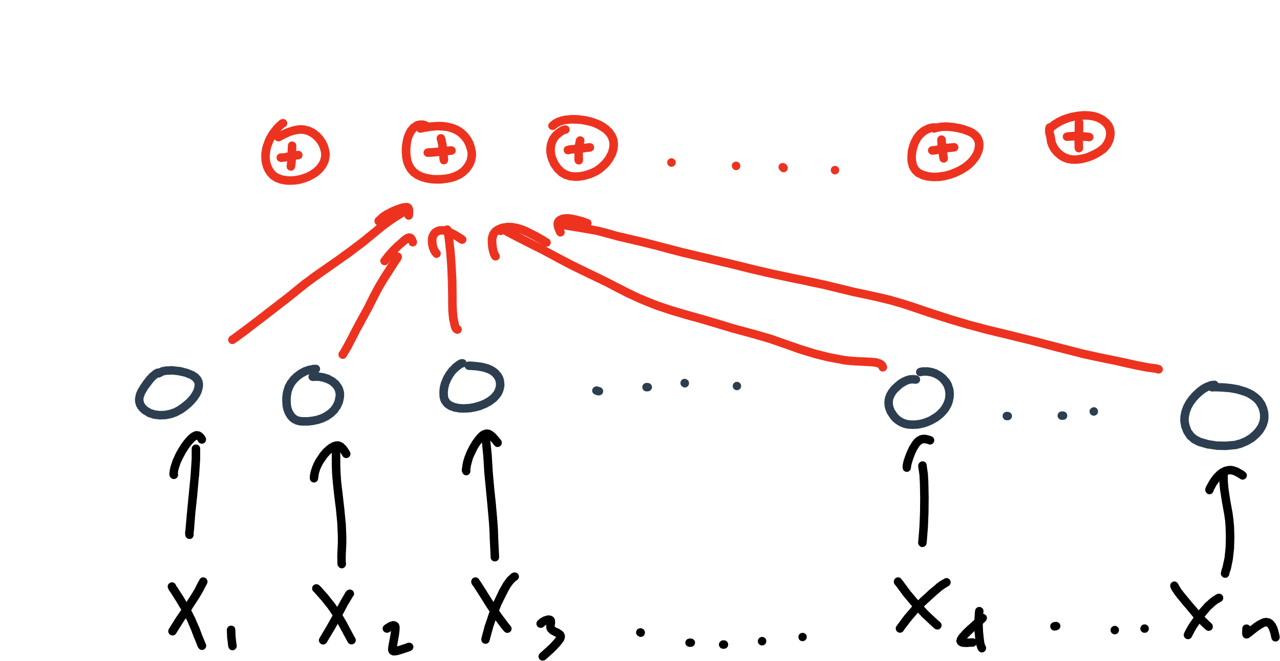

Slide 23
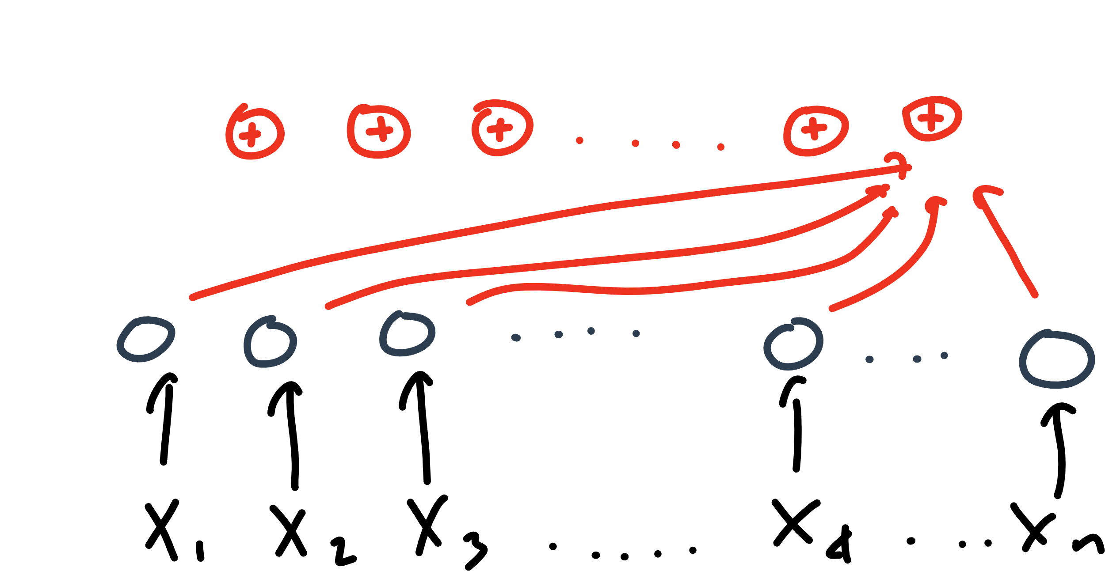

Slide 24
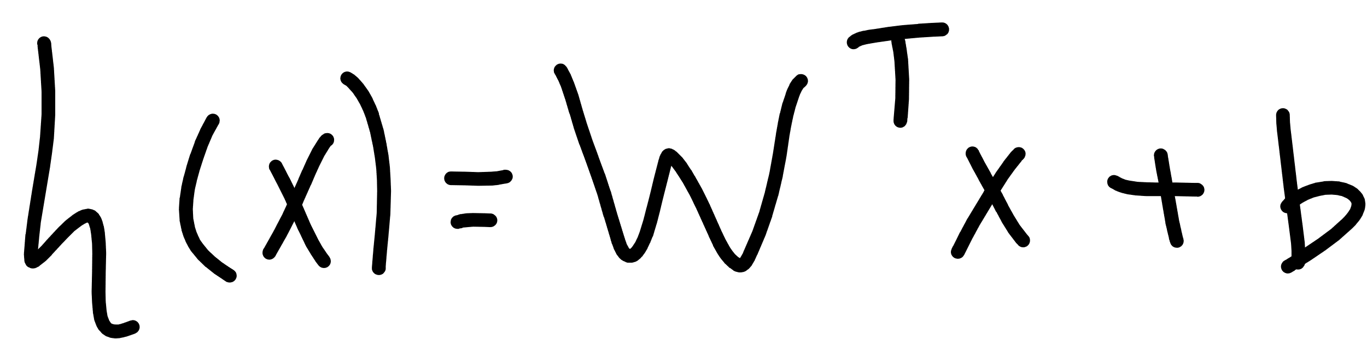

Slide 25
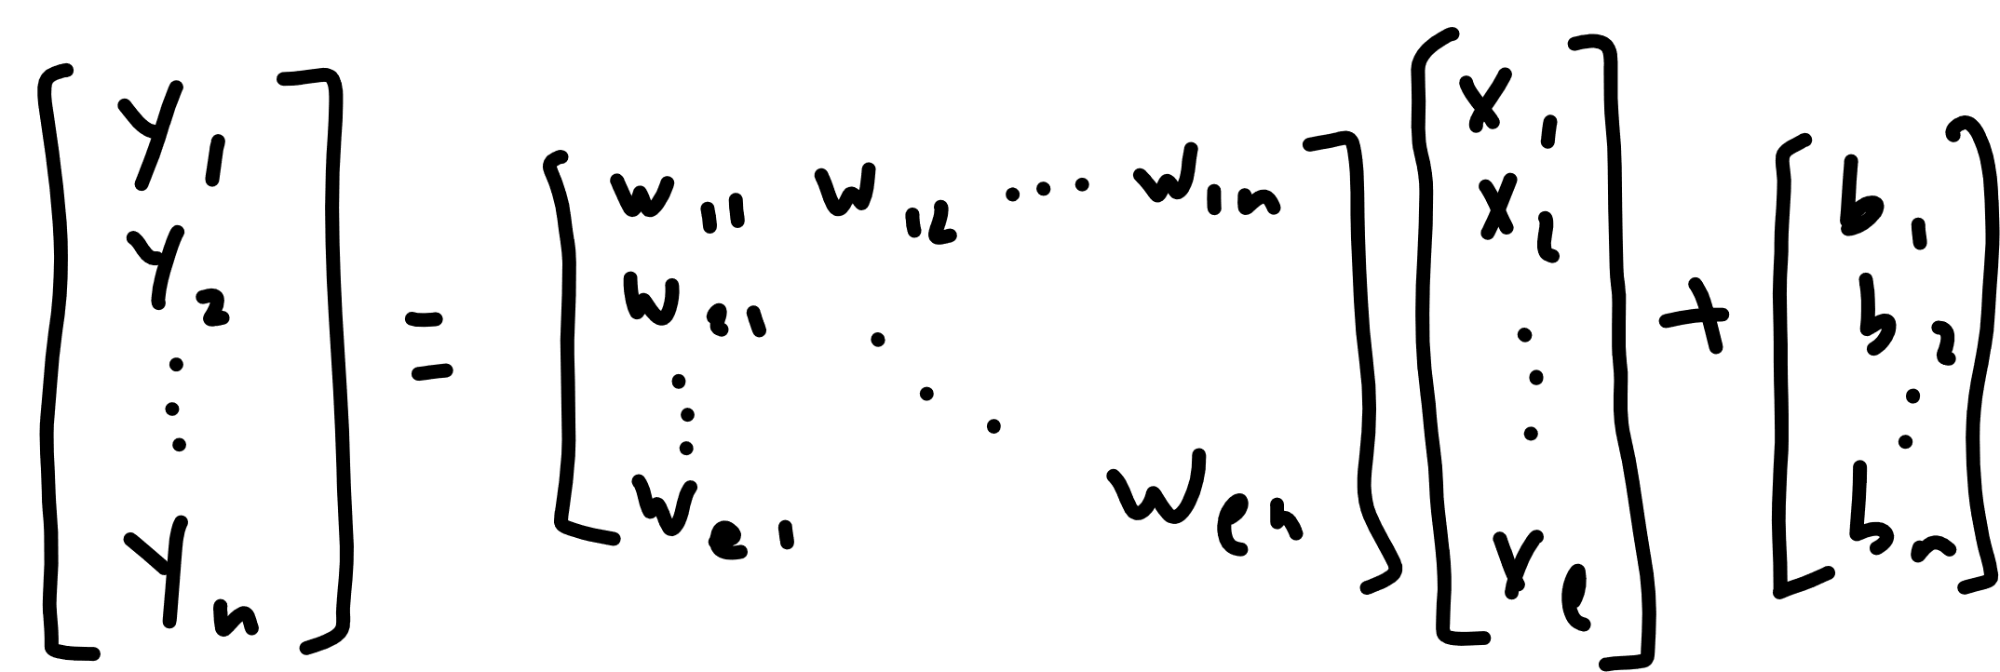

Slide 26


Slide 27
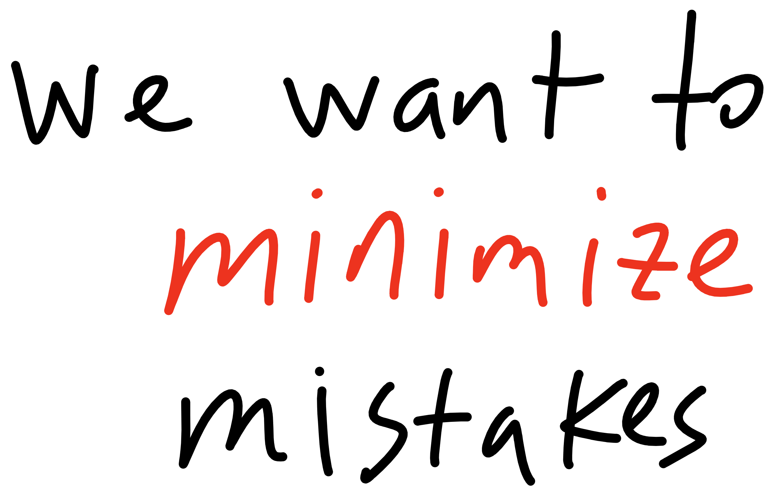

Slide 28
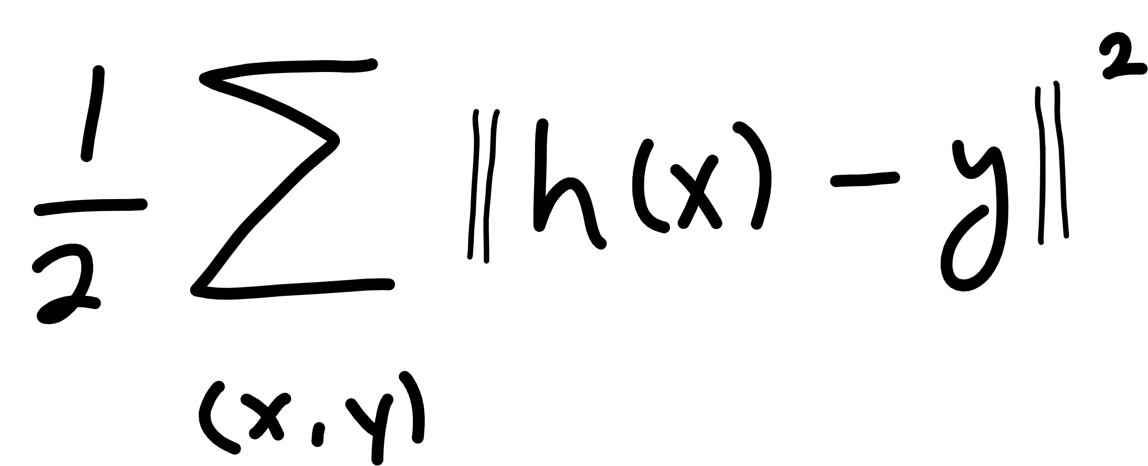
Notes:
Cost function
(WHERE IS W???)

Slide 29
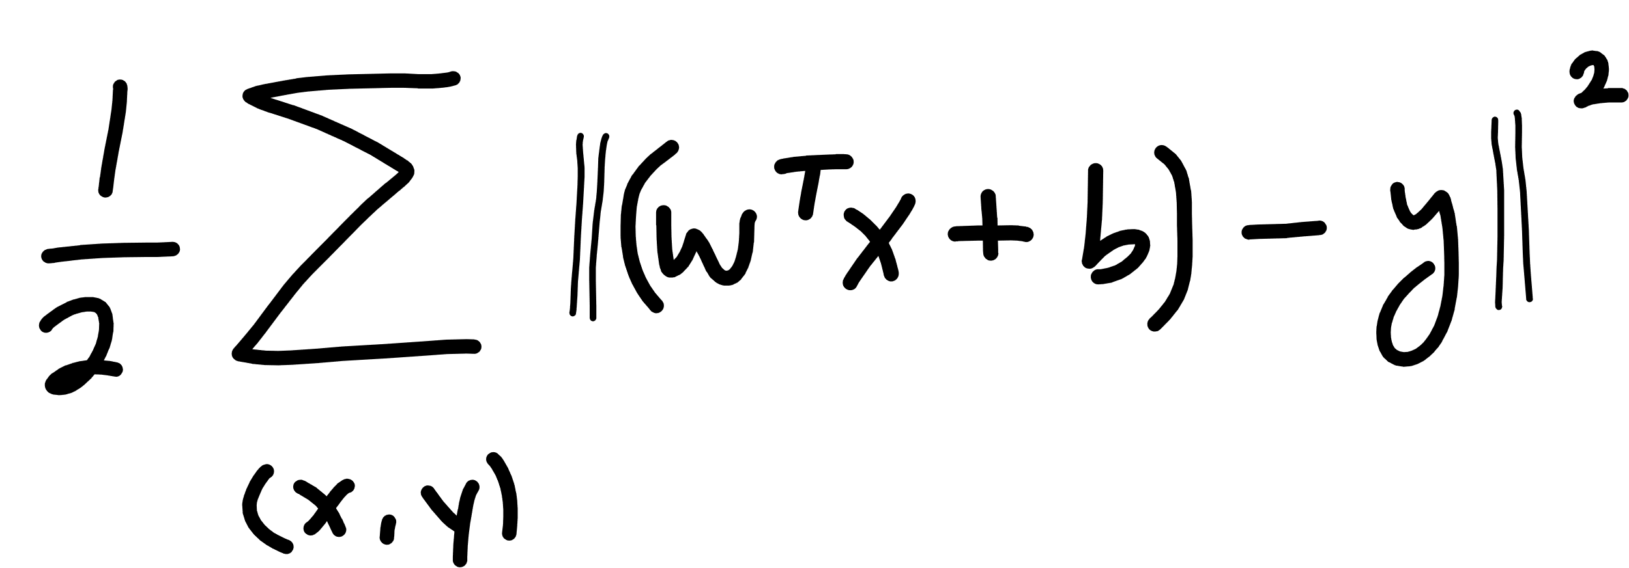

Slide 30
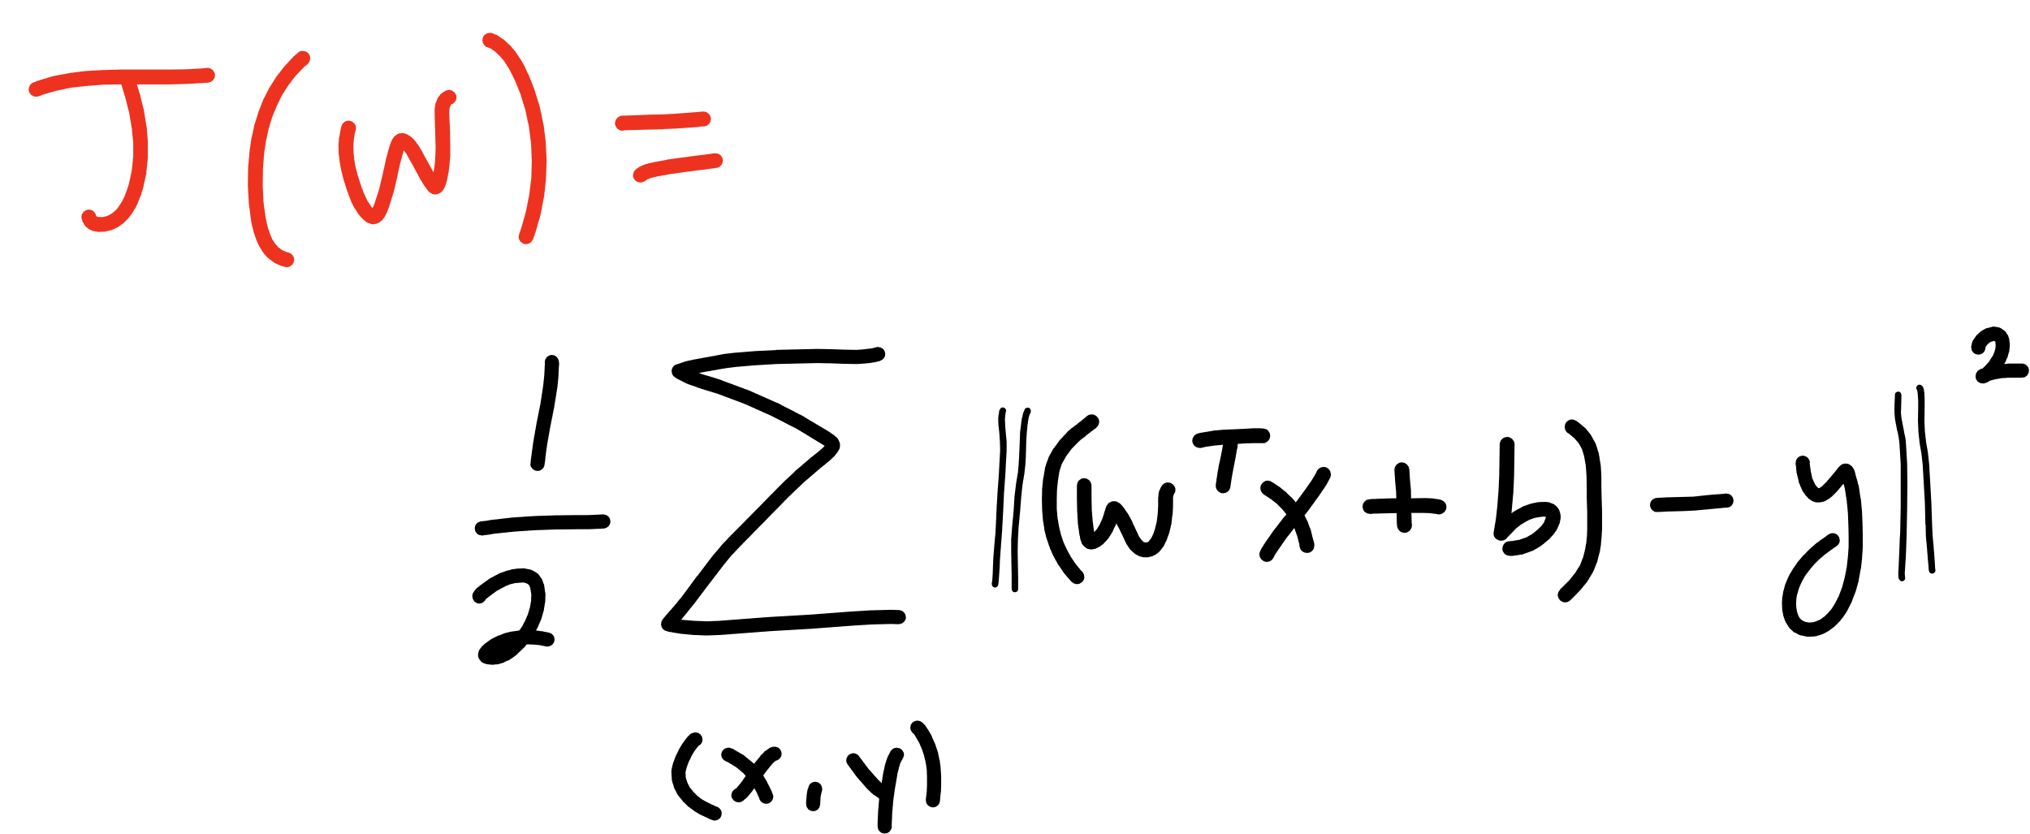

Slide 31
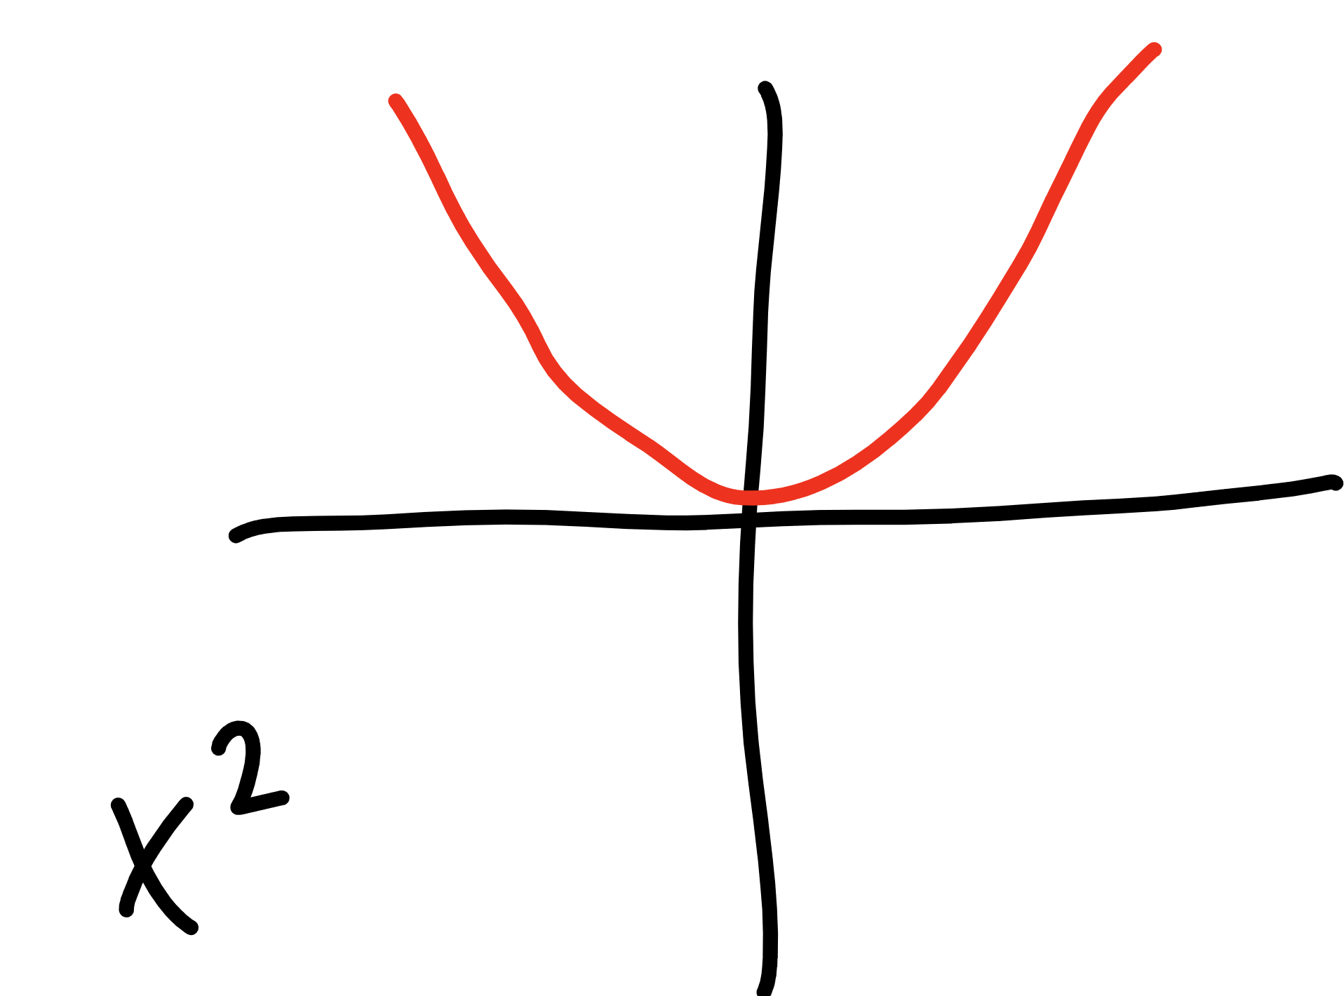

Slide 32
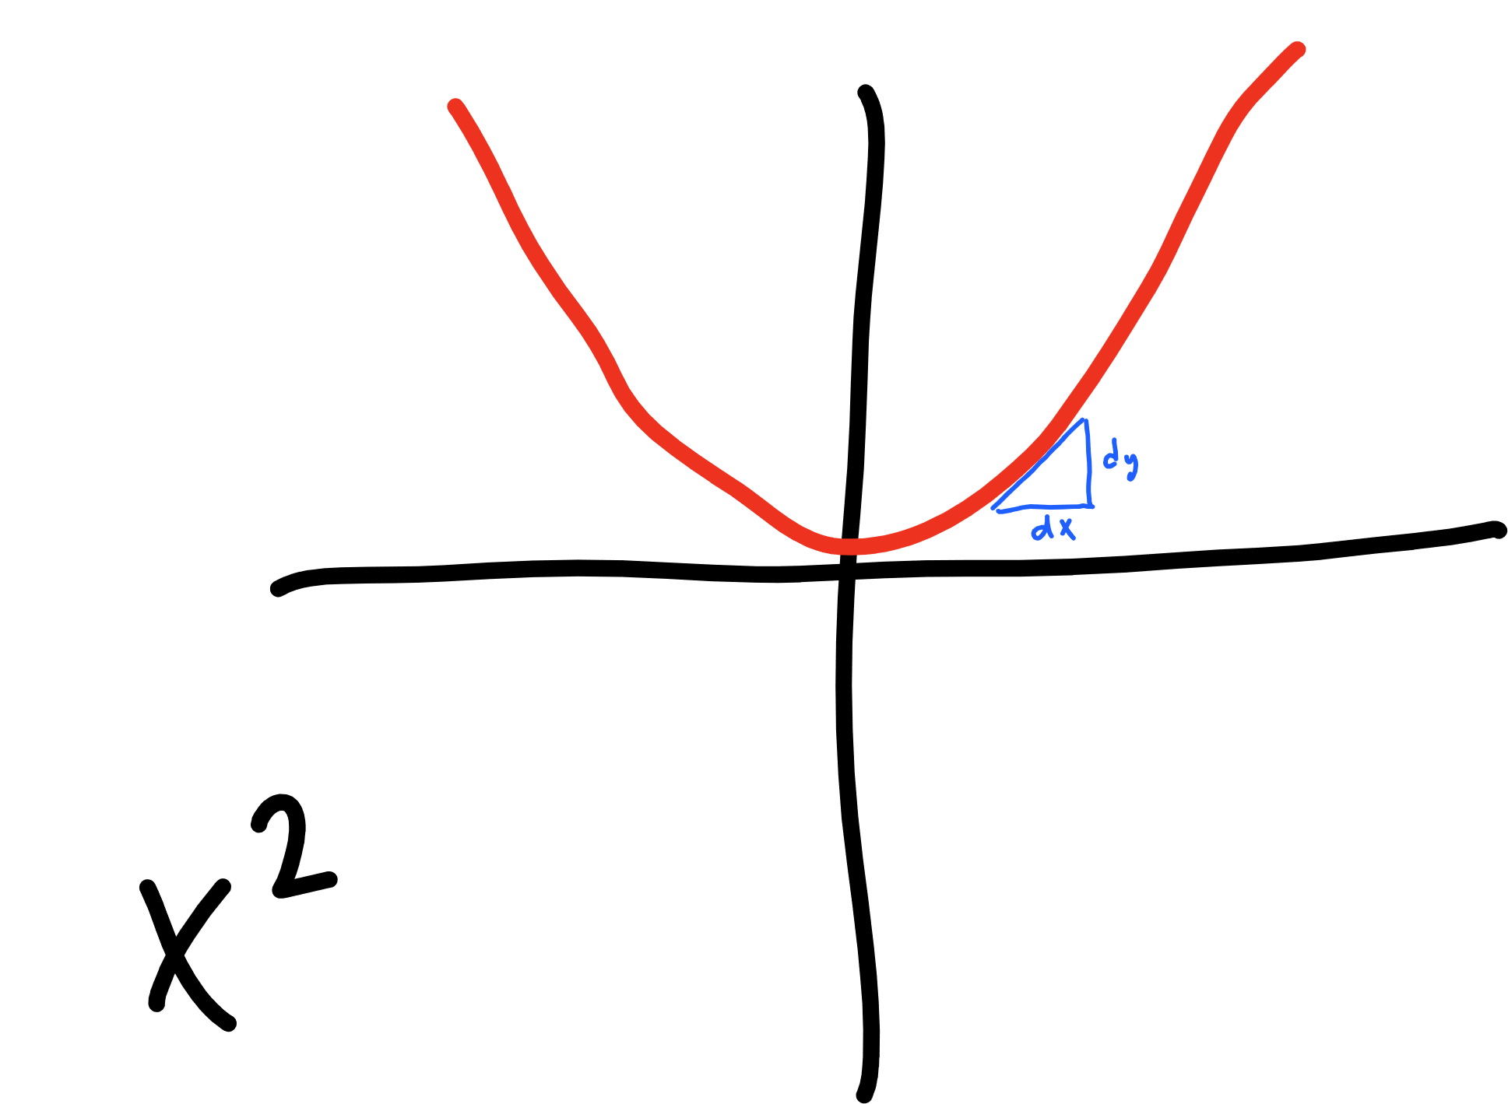

Slide 33
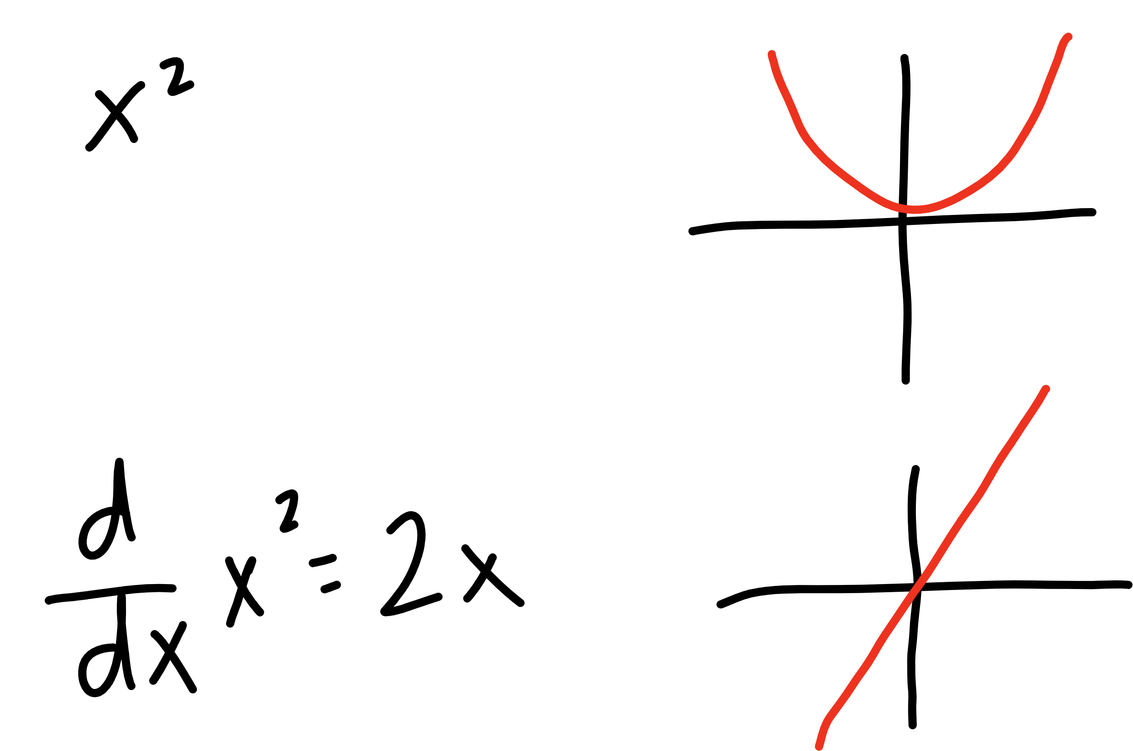

Slide 34
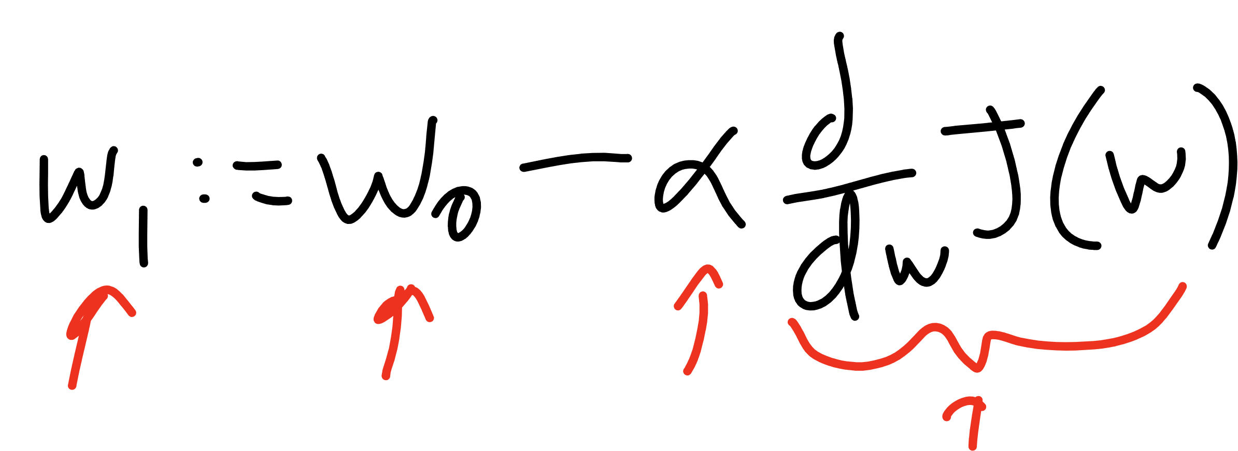
Current W
Learning Rate
Updated W
Derivative of
Cost Function

Slide 35
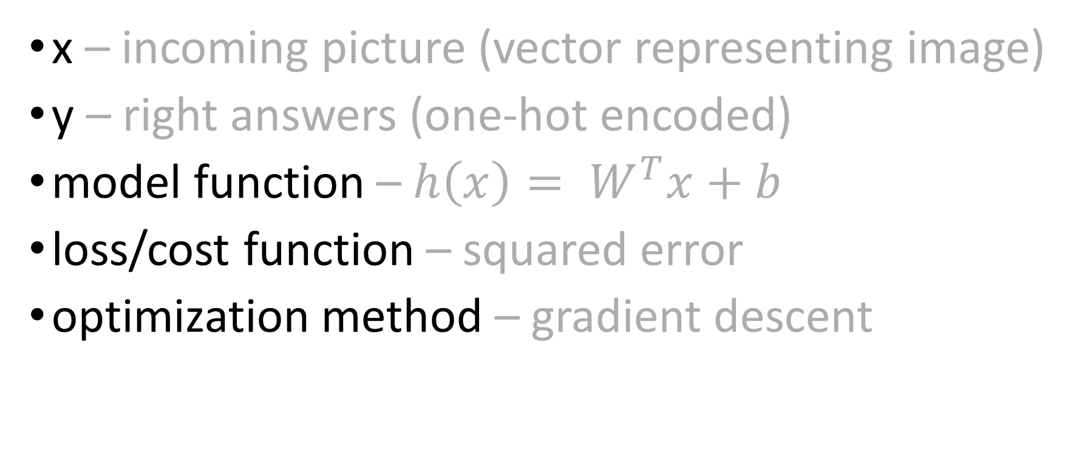
so far…
x – incoming picture (vector representing image)
y – right answers (one-hot encoded)
model function – $h\left(x\right)= W^{T}x+b$
loss/cost function – squared error
optimization method – gradient descent

Slide 36
TensorFlow
Step 1 – Define a Graph
Step 2 – Start a Session
Step 3 – Run!

Slide 37
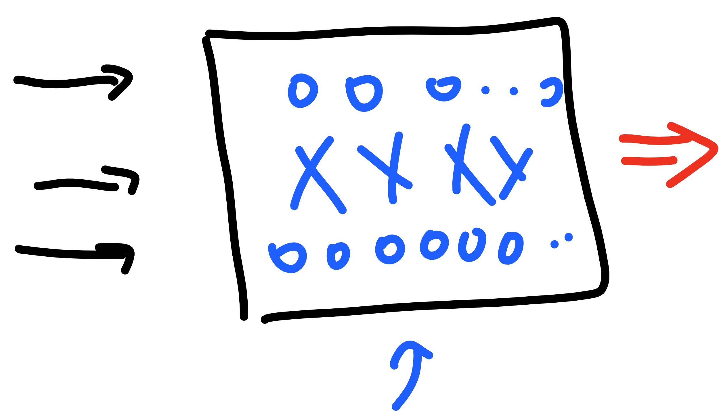
TensorFlow – Building the Graph
placeholders
graph
variables
constants
x, y, model, cost, accuracy, optimization…

Slide 38
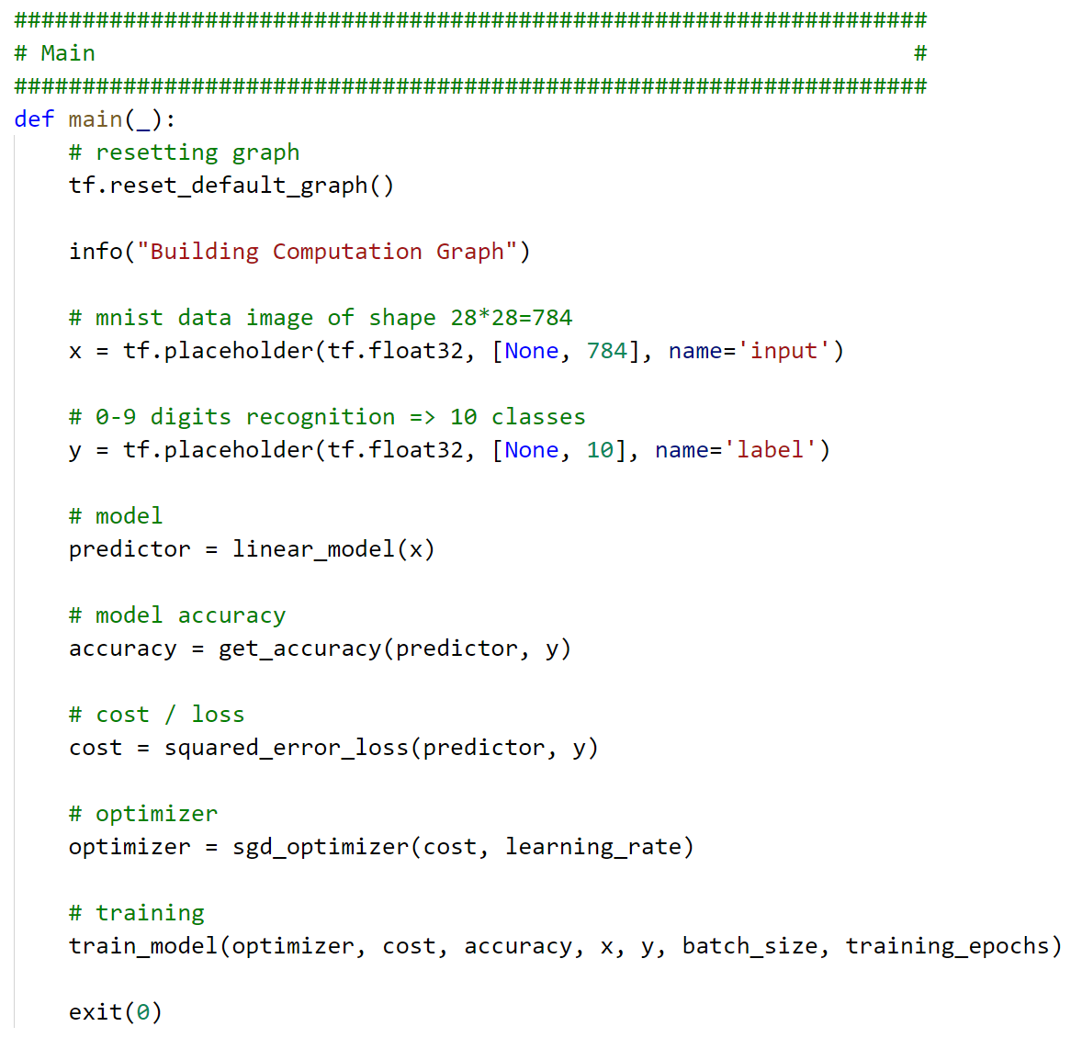

Slide 39
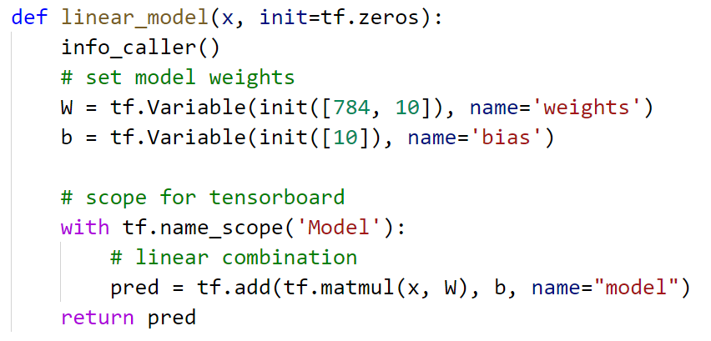


Slide 40
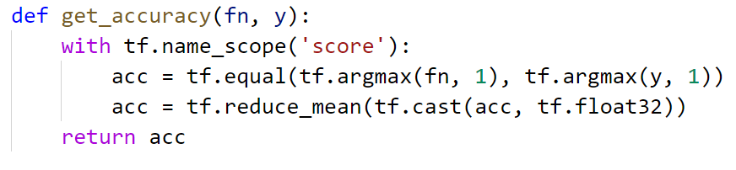


Slide 41
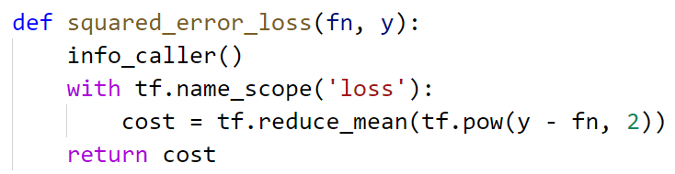

Slide 42
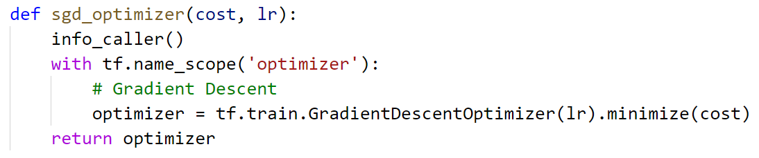


Slide 43
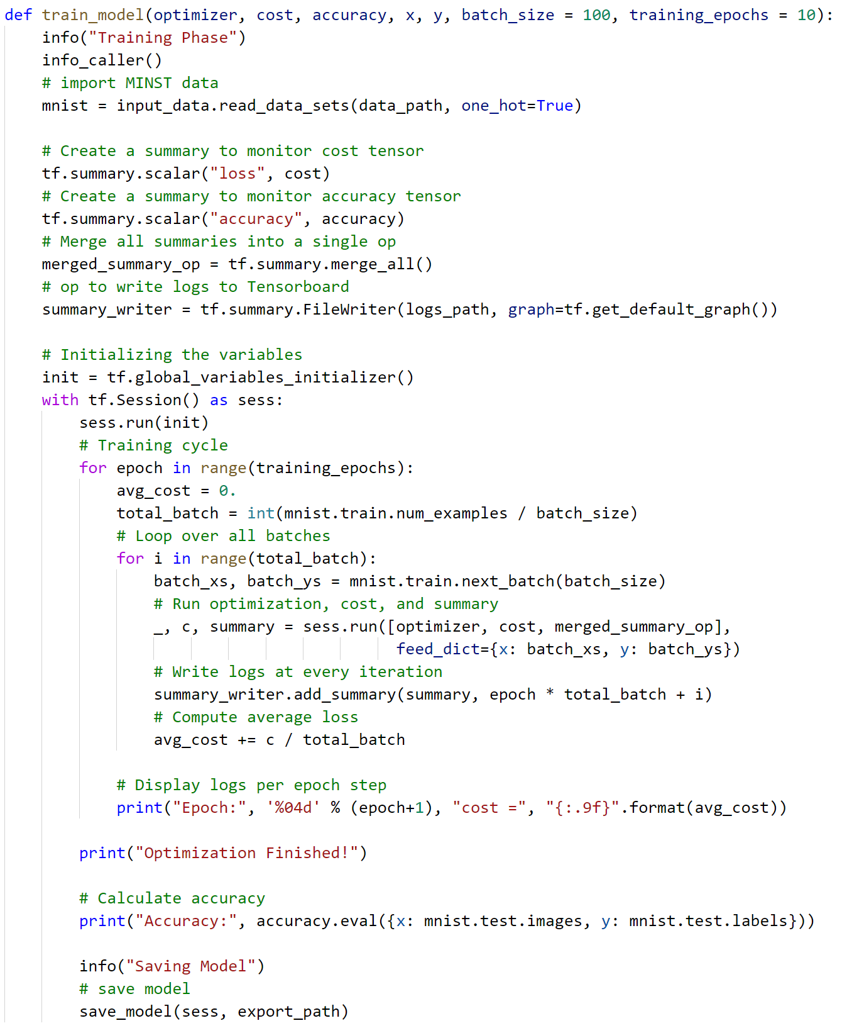

Slide 44


Slide 45
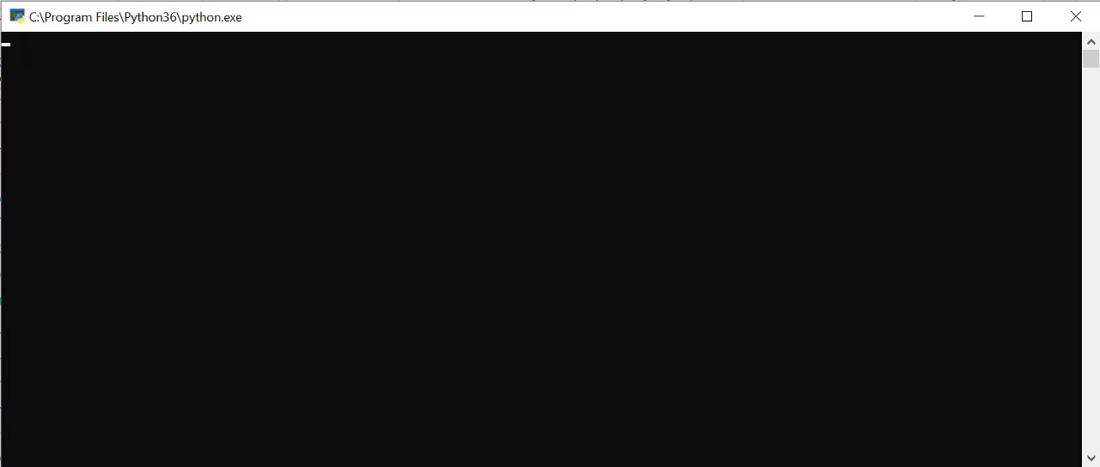

Slide 46
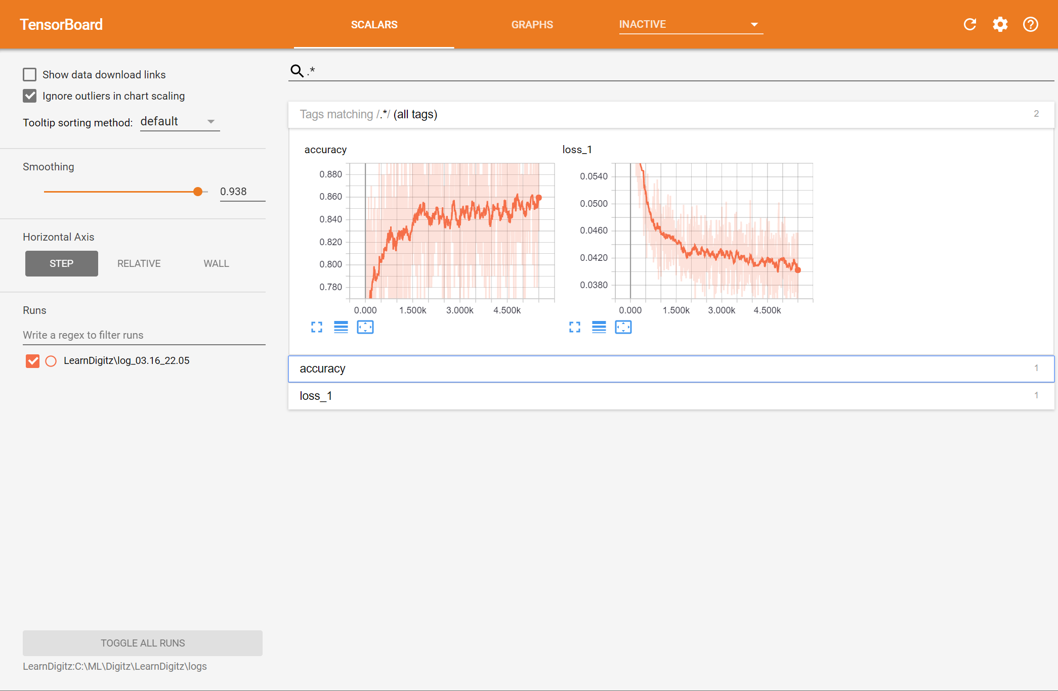

Slide 47


Slide 48


Slide 50
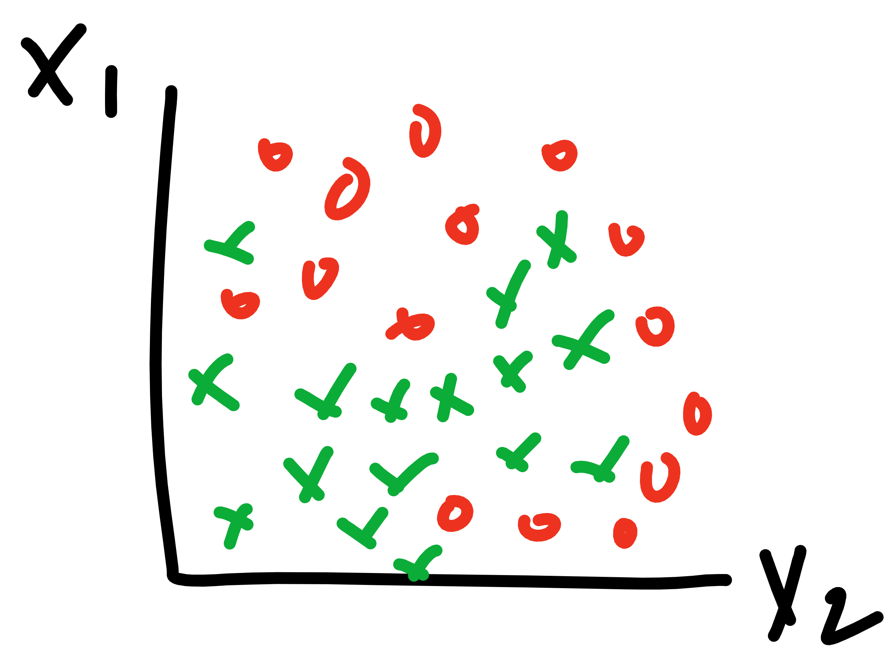

Slide 51
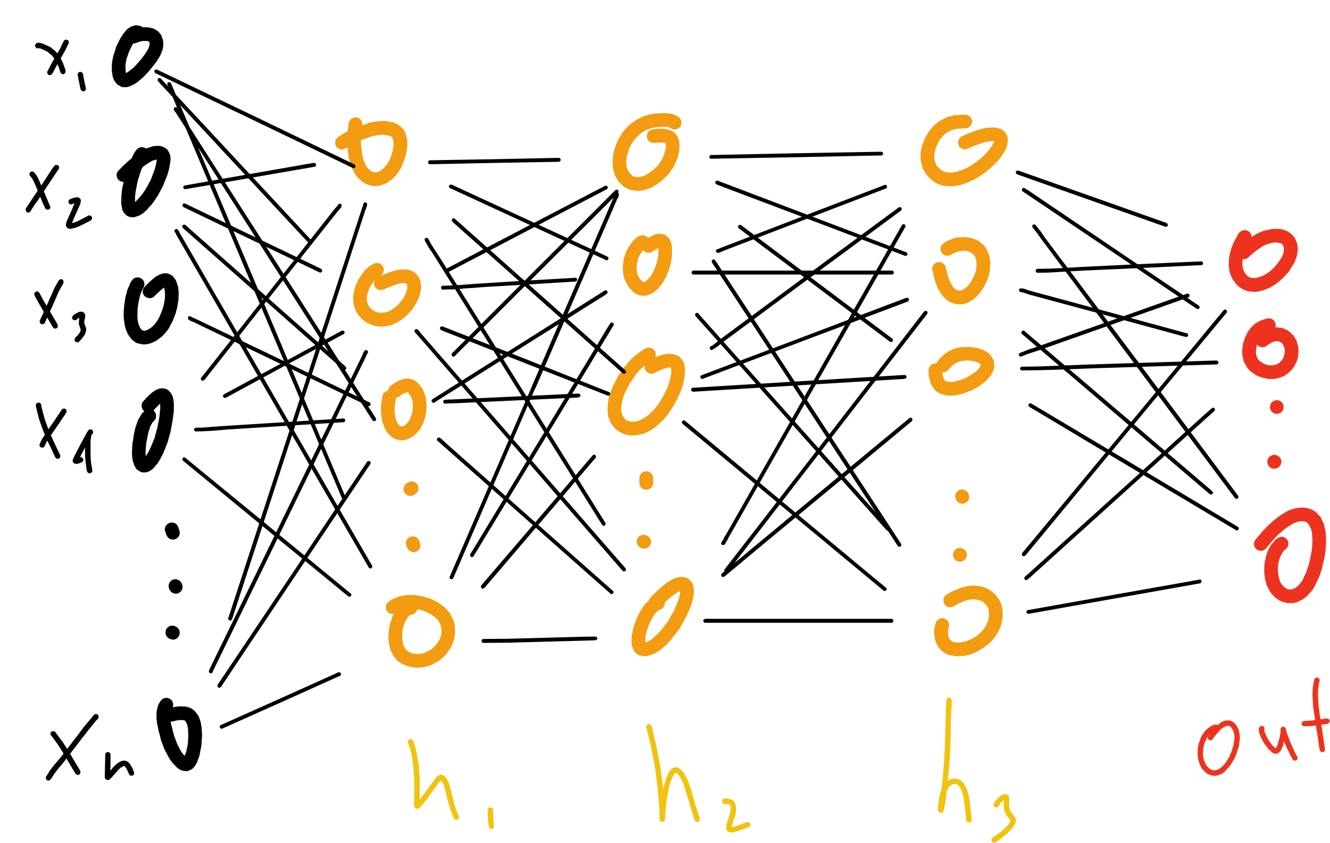

Slide 53
Notes:
Proof by induction

Slide 54
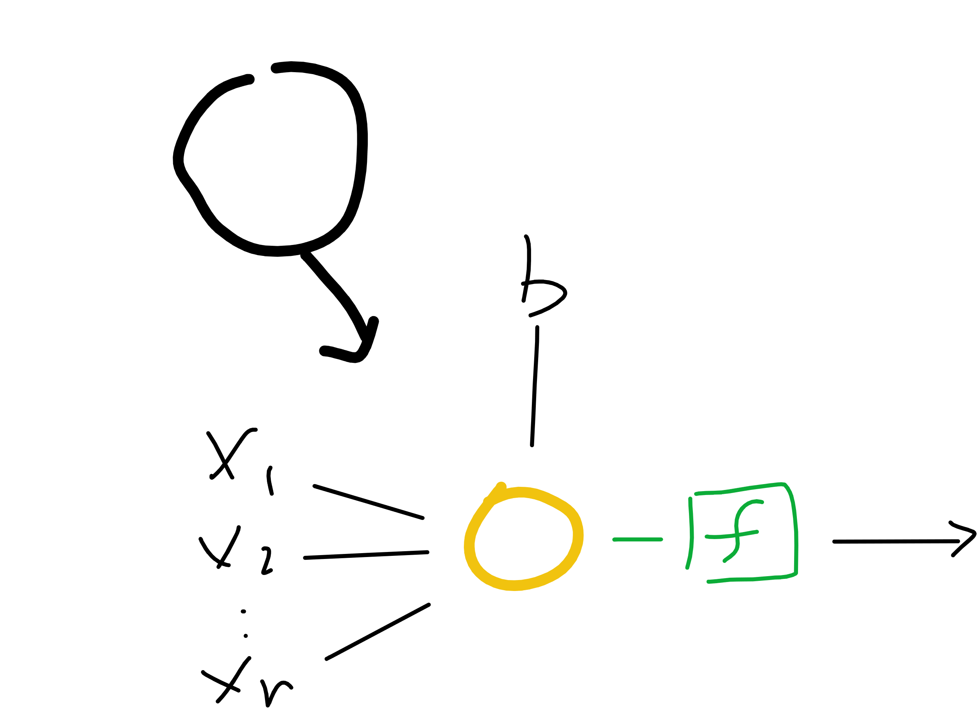
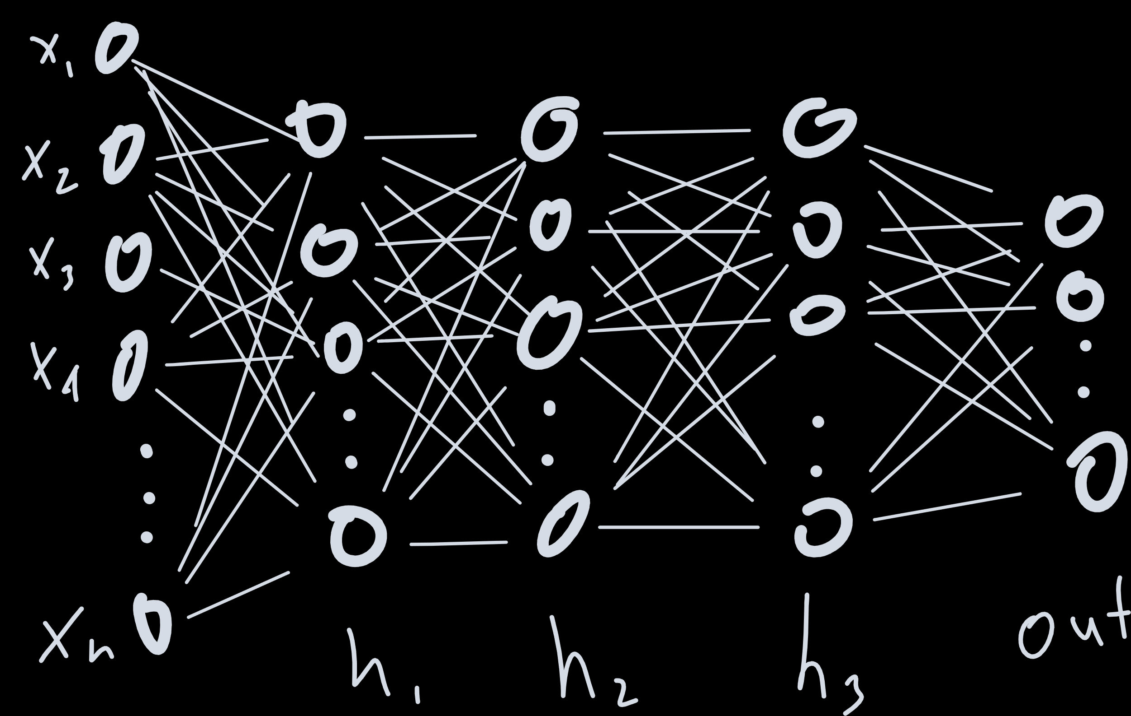
Notes:
Proof by induction

Slide 55
Notes:
Proof by induction

Slide 56
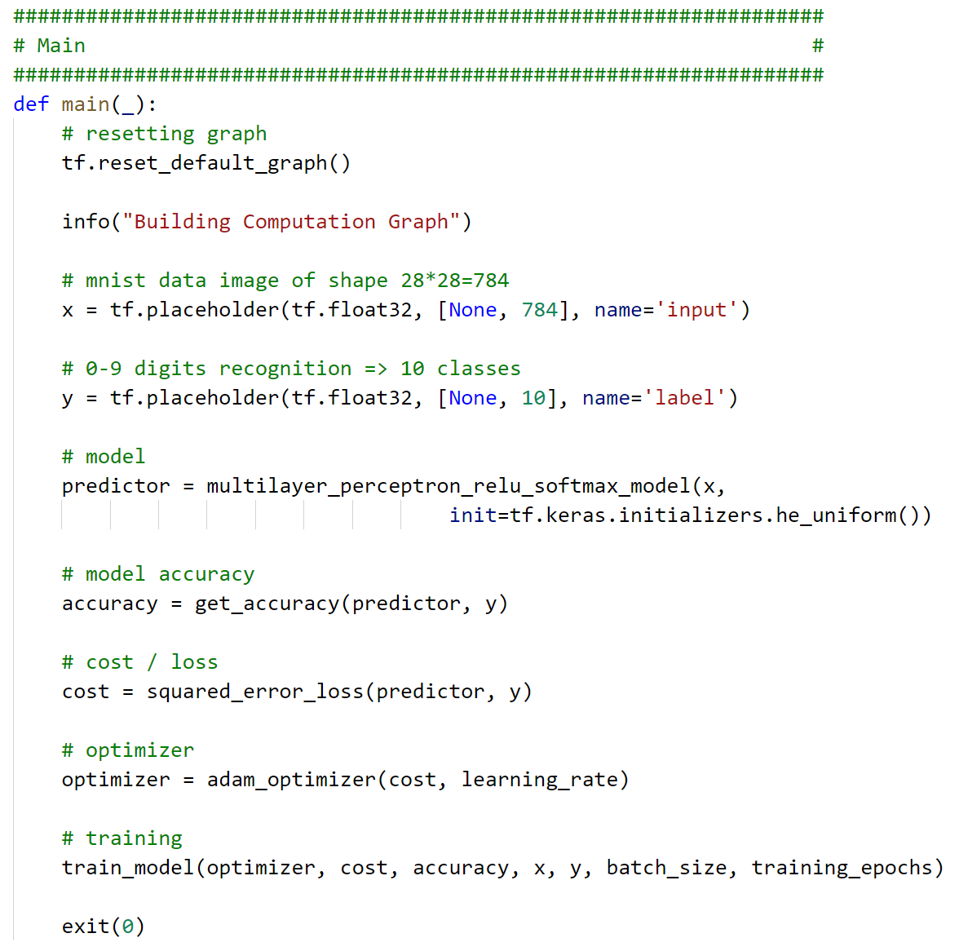

Slide 57
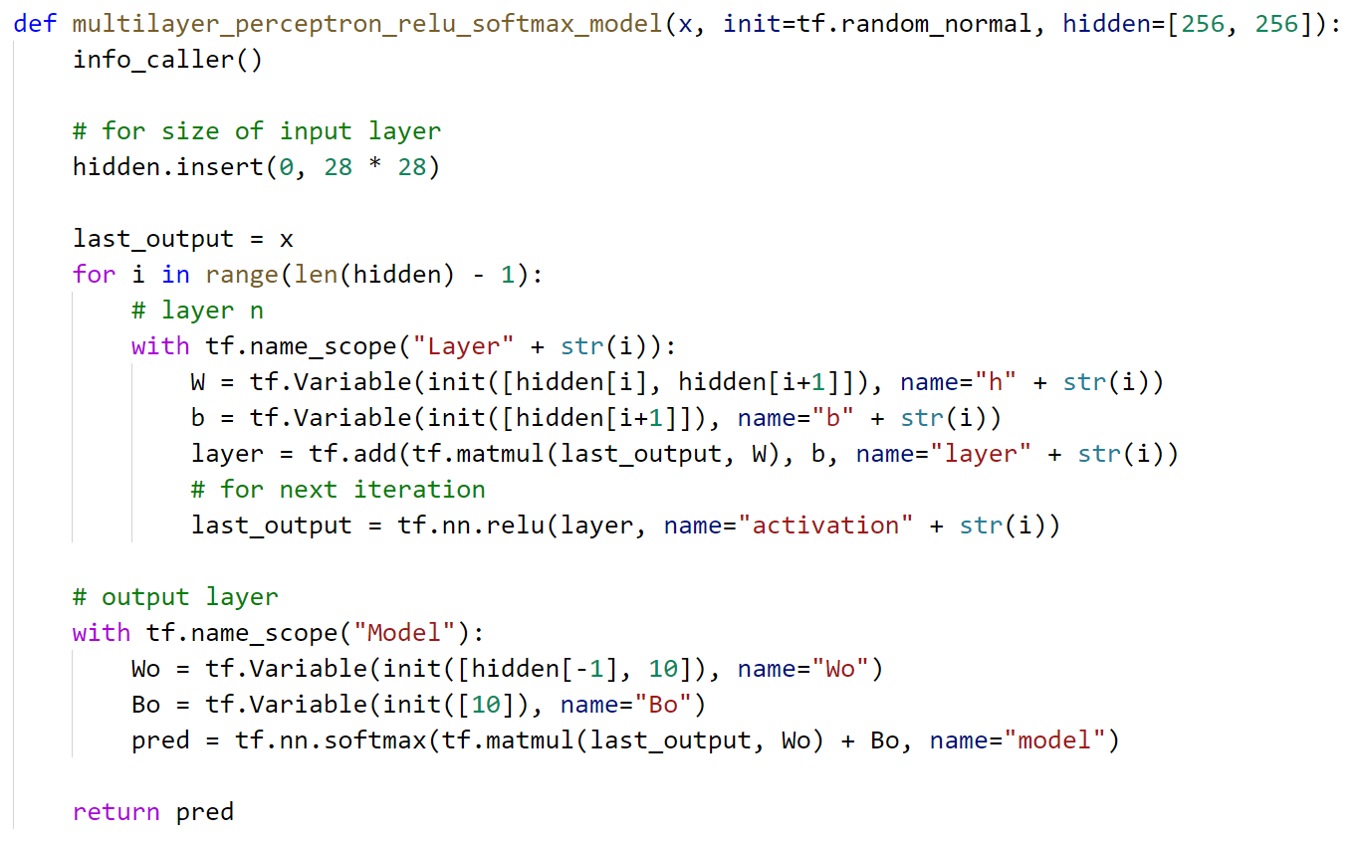


Slide 59


Slide 60
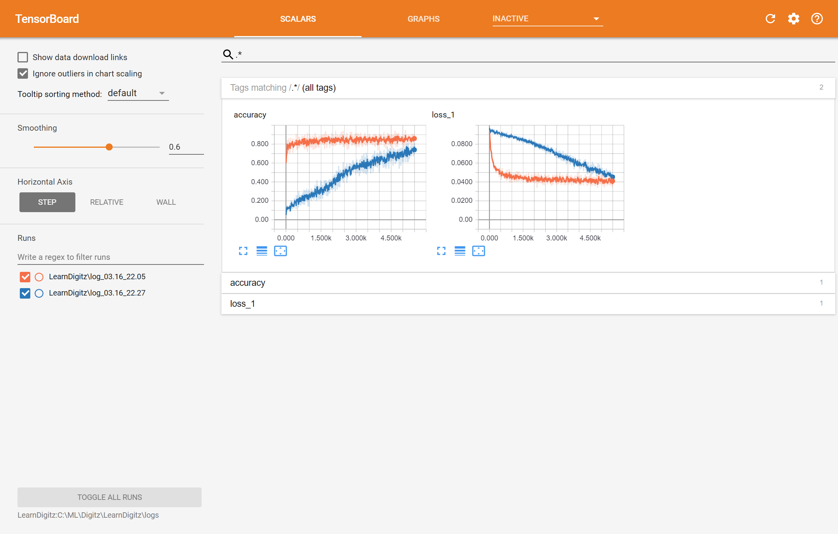

Slide 61
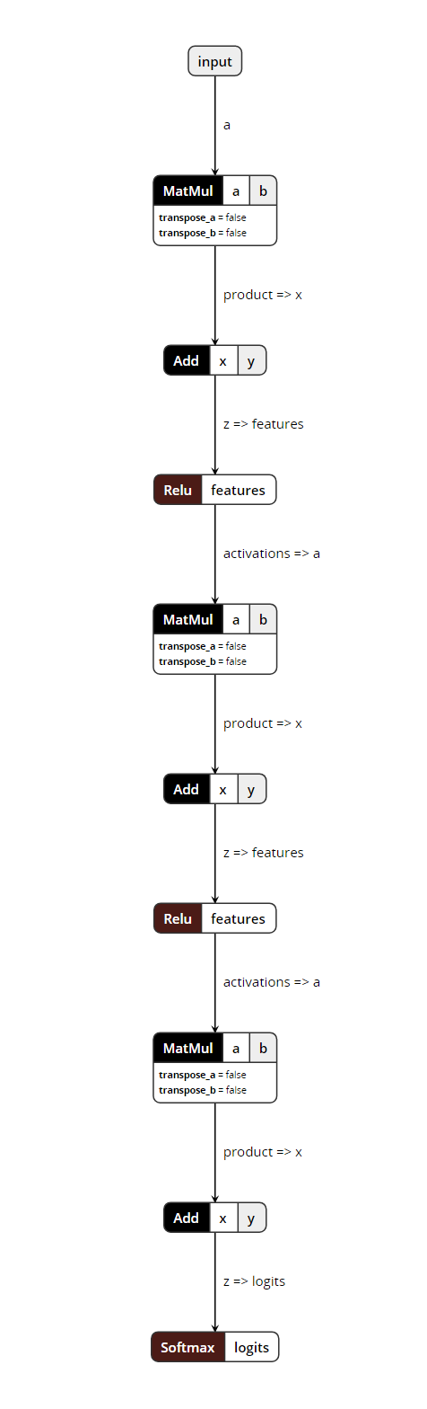

Slide 62
Notes:
Derivative?
Architecture

Slide 63
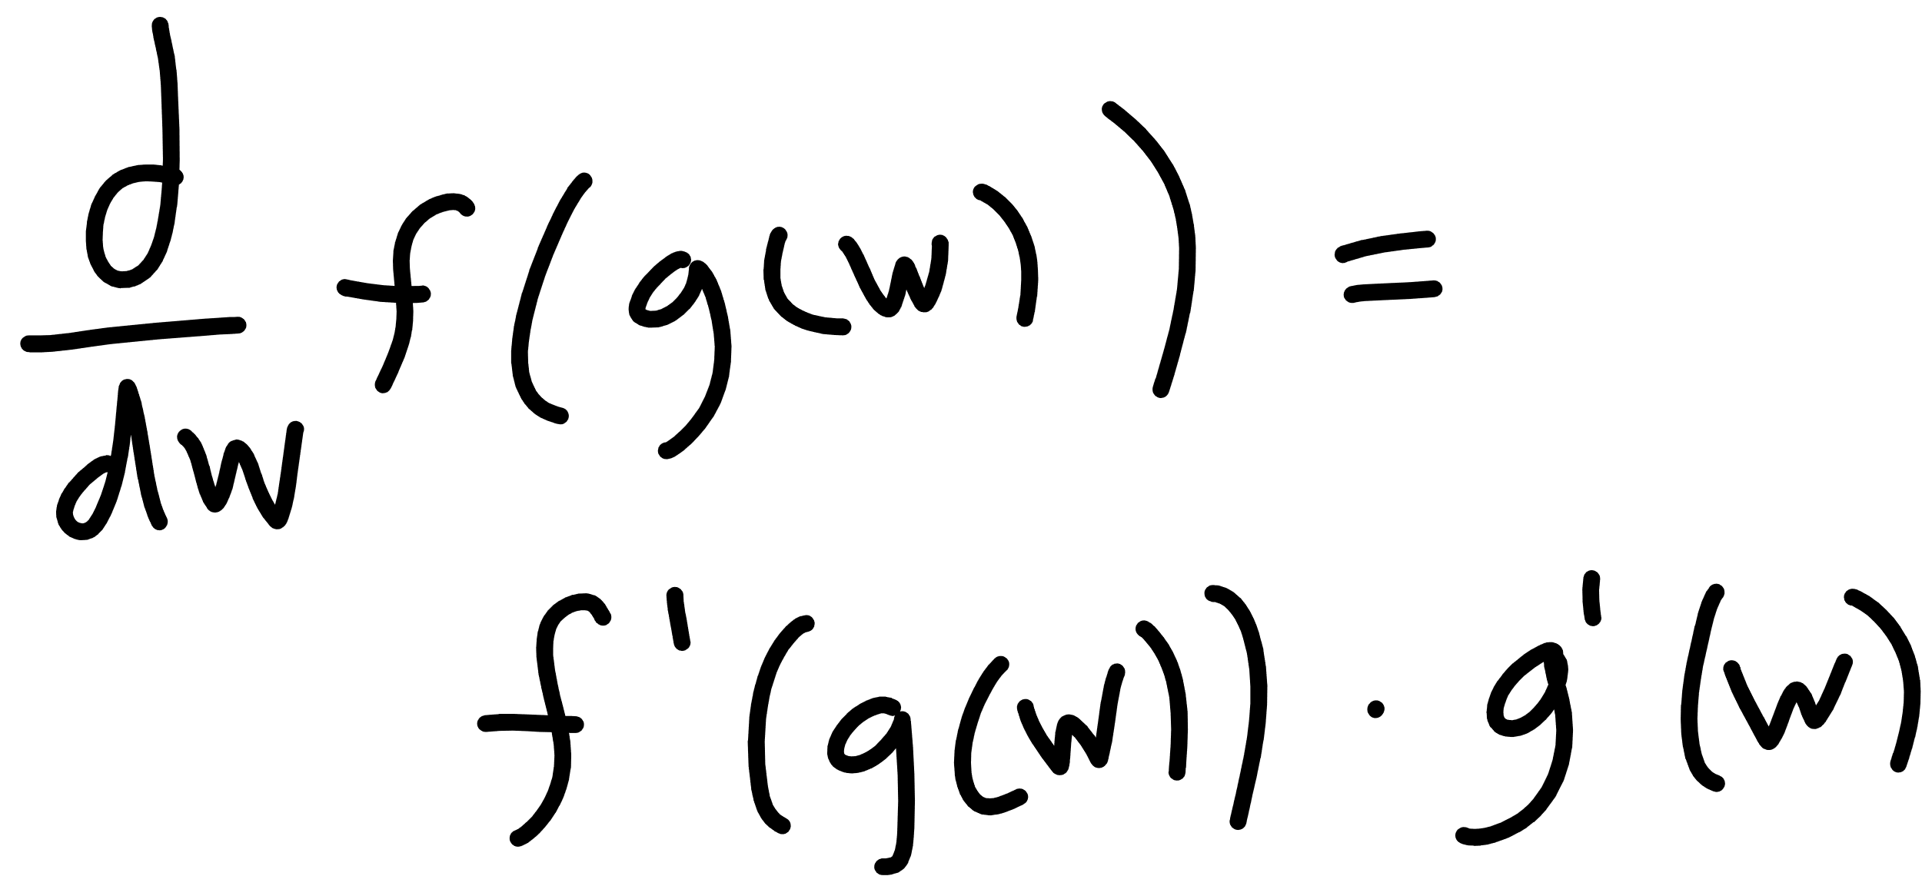

Slide 64
Notes:
Derivative?
Architecture

Slide 65



Slide 66
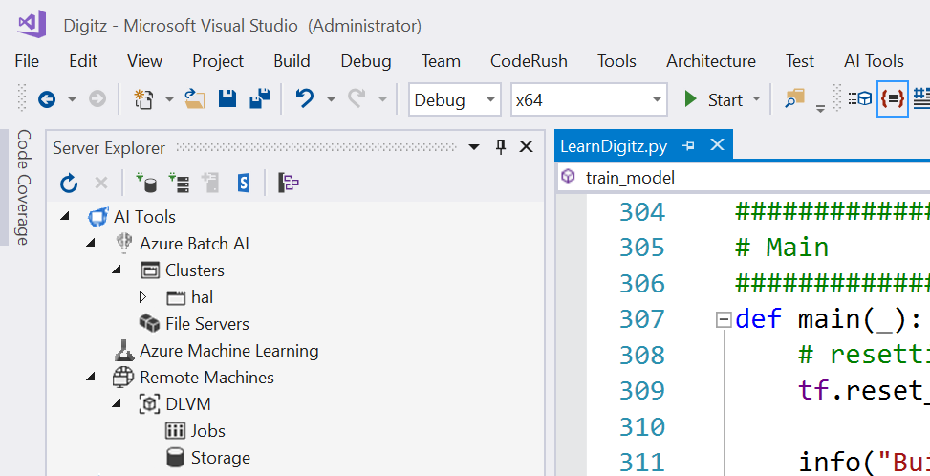
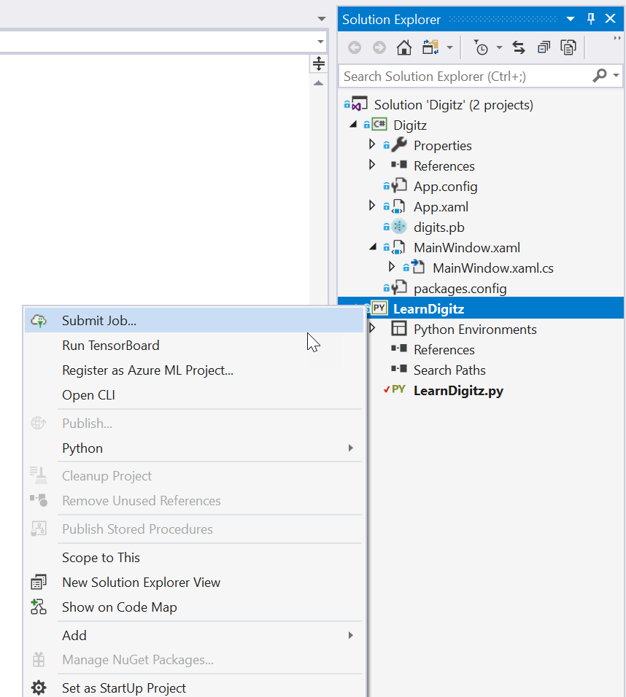

Slide 67
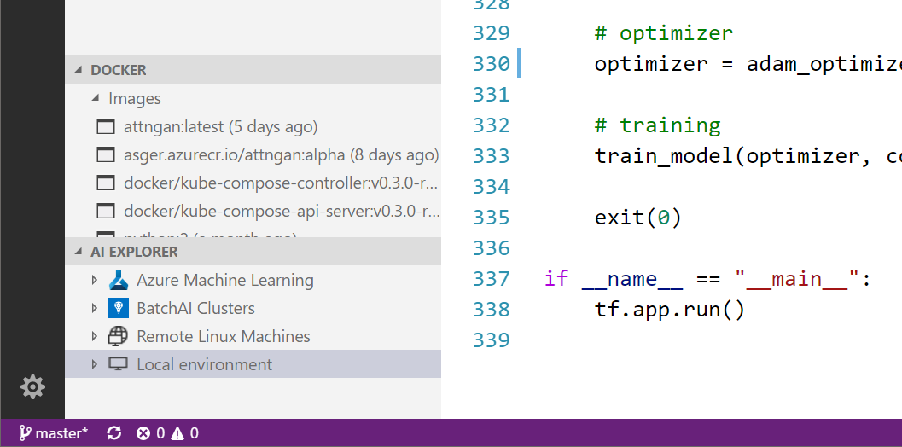

Slide 68

http://www.asimovinstitute.org/neural-network-zoo/

Slide 69

summary
machine learning is about finding $h(x)$ given examples instead of steps
deep learning is one way to do it!
we need:
input $(x, y)$
model function
cost function
optimization method

Slide 70
summary
TensorFlow is a framework that can help.
steps
define graph
start session
run training

Slide 71
summary
Visual Studio Tools for AI - https://cda.ms/jH
Visual Studio Code Tools for AI - https://cda.ms/jJ
DLVM’s - https://cda.ms/jK
BatchAI - https://cda.ms/jL
AzureML - https://cda.ms/jM

Slide 72

Seth Juarez
Microsoft
@sethjuarez

